Slide 1
Open Press Report OEWG April 21, 2026
Reflection • Impact • Future Direction

Slide 2
Purpose & Context
Share progress and impact
Highlight key projects
Discuss sustainability and next steps

Slide 3
Future-of-OE-at-TRU-Final_report.pdf
Ken Monroe, Chair Dr. Brenna Clarke Gray, Vice Chair
April 30, 2022
Key Takeaways
Strong commitment to accessibility, affordability, and equity
Continued interest in OER and open practices across disciplines
Shift toward shared responsibility and distributed support models
Need for sustainable funding and resourcing
Importance of community, collaboration, and institutional alignment

Slide 4
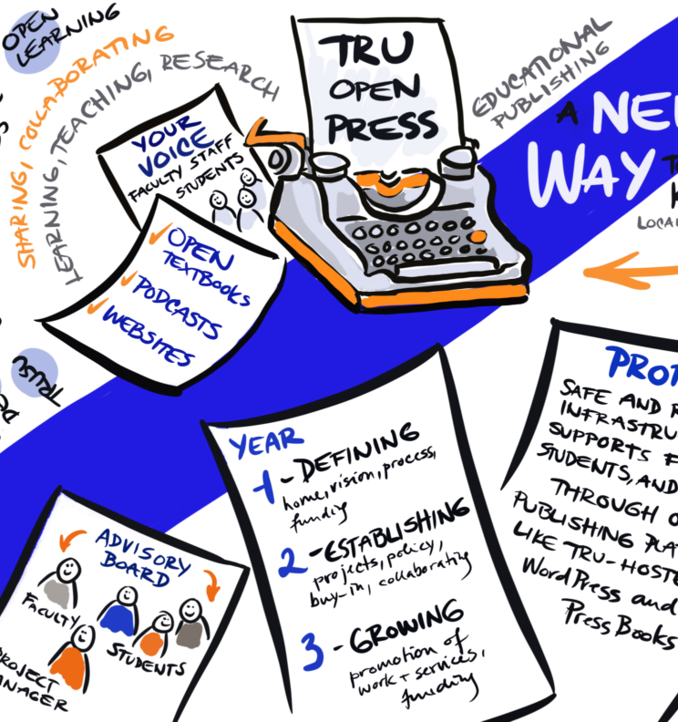
What is TRU Open Press?
Founded in 2023 through TRU’s ISP initiative and Open Education advocacy
Closely connected to the Open Education Working Group (OEWG)
A central hub of publishing expertise supporting OER and open practices
Open Press Matters
Expanded access to high-quality learning materials
Enabled collaboration and innovation in teaching
Reduced costs for students and institutions
Supported adaptable, reusable, and community-driven resources
Core Purpose
To support students and educators in creating, sharing, and improving open educational resources through collaboration and expert publishing support

Slide 5
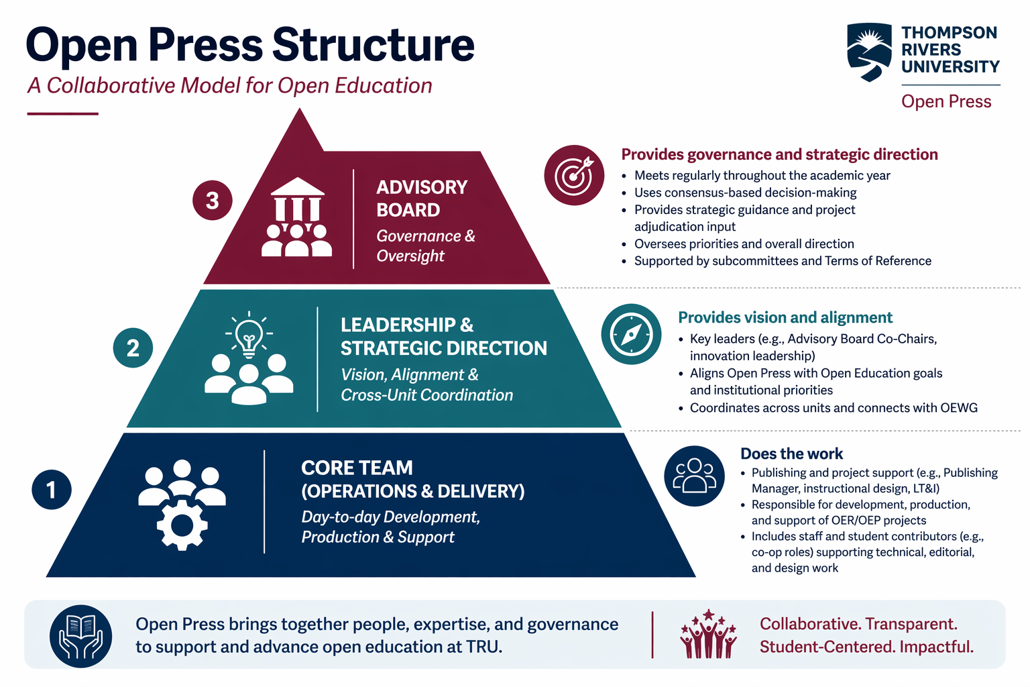

Slide 6
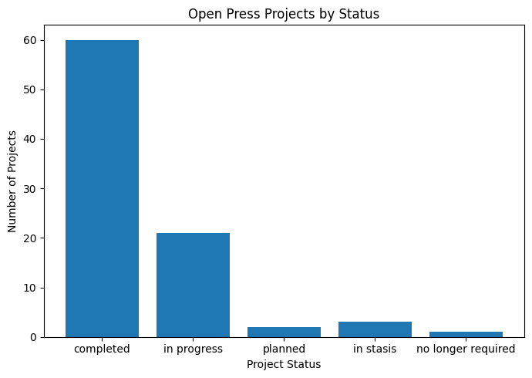
Open Press at a Glance
65+ projects (~80 projected)

Slide 7
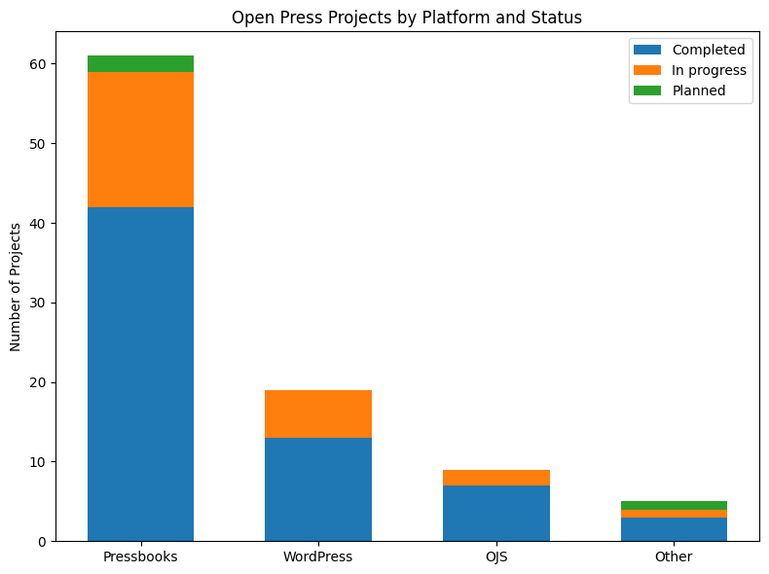
Open Press at a Glance
Outputs: textbooks, H5P, videos, journals/articles

Slide 8
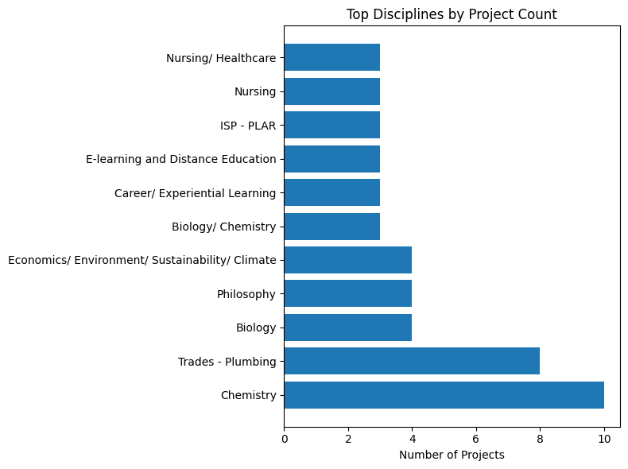
Open Press at a Glance
Cross disciplinary
Full campus and Open Learning support

Slide 9
Impact at a Glance
Students
Lower costs
Better access
Active roles
Instructors
OER + OEP support
Clear Guidance
Collaboration
Institution
Equity
Accessibility
Affordability
Open Press reflects broad, campus-wide engagement, not isolated projects
11 Co-op Students
35 Research Assistants and Student Creators
422 Students as Co-authors and OER developers
~80–120 faculty and project developers involved
Cross-disciplinary participation across TRU
Local, National and Global usage tracking!
Aligns with Strategic Goals of Institution:
Access, equity, and affordability
Teaching innovation and student success
Research and community impact
Notes:
Advances access, equity, and affordability by reducing student costs and removing barriers to learning materials Supports teaching innovation and student success through open pedagogy, interactive resources, and student-as-partner approaches Strengthens TRU’s research and community impact by enabling open scholarship, collaboration, and global knowledge sharing

Slide 10
Conservative estimates based on project counts and typical course enrollment, with expanded reach reflecting the open and shareable nature of OER.
268+ Students involved in development
≈ 3,960 students (direct TRU classroom use)
Projects adopted provincially, nationally, and globally!
Estimated Student Reach
~4,000 students (TRU direct use) ⬇ 8,000–12,000 across BC ⬇ 12,000–20,000 across Canada ⬇ 20,000–40,000+ globally
From ~4,000 students at TRU to potentially 40,000+ learners globally
Note: This is cumulative—numbers will increase for as long as the resource is used over the next few years.
Notes:
Development refers to students who helped create OER; usage refers to students who used these resources in their courses.

Slide 11
Student Savings Impact
$240K – $400K
~4,000 students impacted
Each circle icon represents ~200 students
Open Press OER → meaningful financial impact at scale

Slide 12
Student Savings Impact
Global
20K–40K+ students
Canada
12K–20K students
TRU
$240K–$400K
~4,000 students
BC
8K–12K students
Open Press OER impact expands from TRU to global learners

Slide 13

Future Earth Student Journal https://publishing.bceln.ca/index.php/future-earth/
What It Is
Student-led journal
Sustainability focus
OJS platform, hosted by BC ELN
Why It Matters
Builds research culture
Cross-unit collaboration
What Students Gain
Research skills
Academic review and rigour
Academic publishing experience
Notes:
Student sustainability journal
Built on Open Journal Systems
Hosted via BC Electronic Library Network

Slide 14
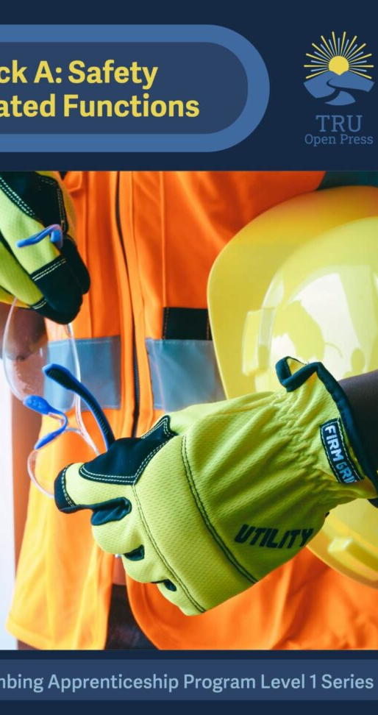
Plumbing OER (Levels 1 & 2)
What It Is
Open textbooks aligned with SkilledTradesBC curriculum (permission from STBC)
Covers core apprenticeship training content for BC Plumbing Apprenticeship program
Impact
Used across provincial apprenticeship programs
Supports standardized, accessible training
High-enrolment, high-impact learner group
Why It Matters
Expands OER into Trades + workforce development
Demonstrates real-world, applied impact
Strong external partnerships (SkilledTradesBC and BCcampus, Camosun College – other BC Trades institutions)

Slide 15
Promotion & Outreach
Amplify Awareness
Radio PSAs Campus media
Showcase & Connect
Events & showcases Conference presentations
Tell the Story
Impact stories Interviews
Extend Reach
OER Commons YouTube playlists
OEGlobal
BC Open Education Community (BCOEC)
Provincial engagement, BCcampus collaboration, and community-informed future planning
Strengthening visibility, building community, and
aligning with provincial open education efforts

Slide 16
Community & Collaboration
Internal + external partnerships
BCcampus, SkilledTradesBC, BC ELN
TPC, UTESSA, OEGlobal, Open Education Week engagement
TRULibrary - TRUSpace

Slide 17
Challenges & Constraints
During
Slow start – hiring took a long time (Oct-Dec 2023) after funding was available April 2023
Establishing the Advisory board and subcommittee takes time (Mar/Apr 2024)
Some resistance from other departments (Finance, Marcom, P & C) until they knew who we were and what we were about – some initial direct introduction from leadership may have helped.
Current
End of ISP funding (March 31, 2026)
Some H5P/plugins, custom CSS, etc. may not have been sustainable already – causing features to “break”
Limited capacity for maintenance
Growing demand
Notes:
This level of impact required significant support—and that’s where the challenges emerge.

Slide 18
Open Press 2.0
Keep core values and momentum of Open Press
Shift to scalable support model
Focus on sustainability and shared ownership
Find bridges for funding, resources, collaboration
A survey was sent to project developers and OP stakeholders in March 2026 to determine needs/ interest and best way forward.

Slide 19
OER Survey Key Findings (March 2026)
👥 Strong Engagement
100% use OER
88% create/adapt
98% support OER
🎓 Student Impact
↑ Access & accessibility
↑ Engagement & outcomes
Co-creation valued
🤝 Faculty Value
Improved teaching
More collaboration
Greater recognition
🔄 Sustainability
Regular updates needed
Moderate support
Shared model required
High impact and strong demand — requires sustainable institutional support

Slide 20
OP & OEWG Website as a Hub
Funding opportunities in BC: https://openpress.trubox.ca/the-future-of-tru-open-press/
Development guidance: https://openpress.trubox.ca/creator-resources/
Promotion and dissemination resources: https://openpress.trubox.ca/the-future-of-tru-open-press/canadian-oer-project-dissemination-guide/

Slide 21
Opportunities for OEWG
Promote & Share Resources, Knowledge, Training
Workshops, showcases, and lunch & learns (volunteers ?)
Curated guides, toolkits, and examples
Central hub (Open Press/ OEWG website) for access and support
Support Adoption
Share ready-to-use OER across departments
Highlight adaptable resources and success stories
Encourage low-barrier entry points (adopt, adapt, remix)
Strengthen Open Culture
Normalize OER and open pedagogy practices
Recognize and celebrate open work (awards, showcases)
Embed openness into teaching, learning, and scholarship
Collaboration
Connect faculty, staff, students, and partners
Foster cross-disciplinary and cross-institutional work
Engage with provincial and national open education communities

Slide 22
What Made Open Press Work
Key practices behind success
🤝 Relational Support
High-touch, responsive
Met developers where they were
Standardized, customizable templates to start with
Early training and consultation
Setting task expectations and timelines with all team members
Frequent check-ins, meetings can be called by any team member
Allowing some overlap of tasks over positions as individual interest and schedules permitted.
🧠 Student-as-Partner
Students as co-authors
RA + journal contributions
🧩 Flexible Workflows
Iterative, adaptable, flexible
Not rigid or linear
🌐 Open Sharing
Active promotion
Dissemination brainstorm, planning during project development and afterwards
OER Commons, YouTube
Notes:
This slide highlights the key practices that made Open Press successful. What’s important here is not just what we did, but how we can intentionally carry these approaches into Open Learning—particularly around collaboration, learner-centred design, and flexible workflows. These are the practices that made Open Press successful… and importantly, many of them don’t require the same level of funding—just intentionality in how we work.

Slide 23
What We Carry Forward
Adapting practices for a low-resource environment
🤝 Targeted Support
High-impact touchpoints
Strategic vs full-service
🎓 Learner Integration
Embed student contributions
Where feasible
🧩 Modular Development
Reusable, adaptable content?
Standardized customizable templates to start with?
Phased workflows, but early team consultation (can courses become mini projects in and of themselves with dedicated teams?)
🌐 Lightweight Sharing
Use existing platforms
Sustain visibility

Slide 24
What We Let Go Of — And What We Don’t Lose
Being intentional about sustainability
❌ What We Let Go Of
Fully resourced, high-touch model
Supporting all projects equally
❌ Resource-Heavy Builds
Custom media-heavy production
Long timelines
✅ What We Keep
Collaboration, openness, innovation
Student partnership, meaning, care, and impact
✅ What We Protect
Quality, accessibility, care, impact Institutional alignment
Student Journal/ OJS
Pressbooks, WordPress project platforms
We may scale back resources—but not our values or impact!

Slide 25
Sustaining Momentum
Complete current projects
Plumbing OER (provincial impact)
Journals
Support high-impact initiatives
Continue transition planning
🌱 Sustaining and evolving open education at TRU
Thank You
Questions?
Notes:
We do need to let go of some things—but we’re not letting go of what made this work meaningful.

