Slide 1

TRU Open Press Advisory Board Meeting
Date: November 10, 2025 | Time: 10:00 AM – 11:00 AM

Slide 2
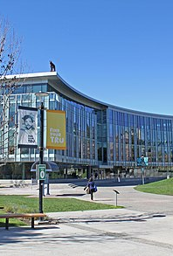
1. Welcome and Acknowledgement
RESPECT | RECIPROCITY | BALANCE
The team at the TRU Open Press is grateful to be visitors on Tk’emlups te Secwepemc territory within the unceded traditional lands of Secwepemcúl’ecw (Secwepemc Nation), where knowledge sharing has taken place since time immemorial.
EXPLORATION | DISCOVERY | STEWARDSHIP
This Photo by Unknown Author is licensed under CC BY-SA

Slide 3
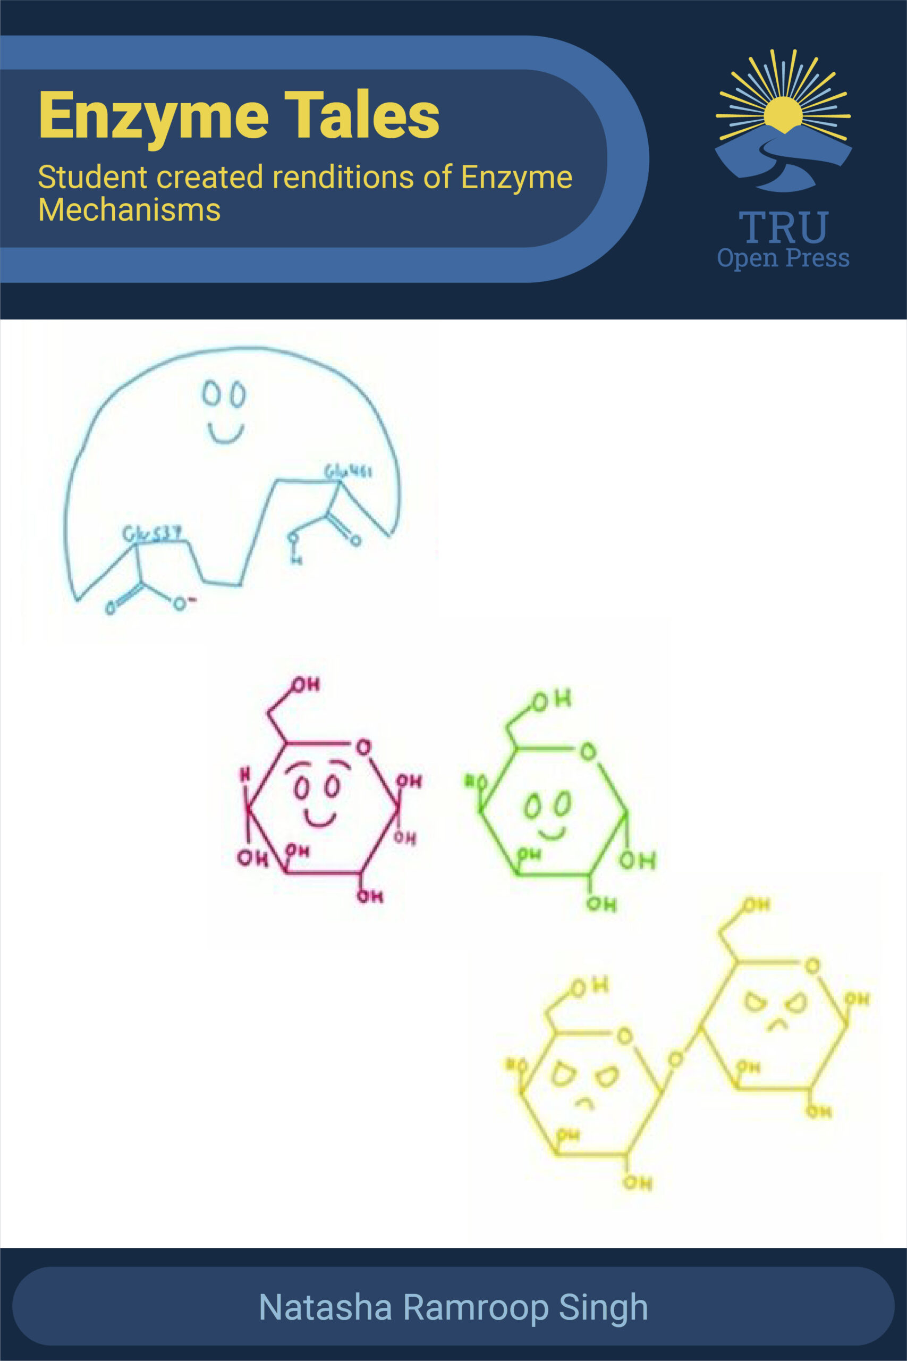
Meeting Agenda
Welcome and Acknowledgement
Approval of Agenda and Previous Meeting Minutes
OP Projects – Status & Updates on Ongoing Projects
Promotion and Awareness Campaigns
Data Collection and Impact Reporting
Open Discussion & Q&A
Action Items Review and Next Steps
Adjournment & Closing Remarks
Notes:
2. Approval of Agenda and Previous Meeting Minutes
Approval of October 8, 2024, meeting minutes.

Slide 4

2. Approval
Welcome Janelle and Chris!
TRUSU Representatives
Agenda for November 10
February 5 meeting minutes
Notes:
Recognize New member: Natasha Ramroop Singh
Bensly graduating soon? Thanks for being our TRUSU representative!

Slide 5
3. OP Projects – Status
Ongoing Projects Adjudicated and Non-Adjudicated:
  10 projects carried forward from 2023-2025
  12 projects adjudicated for 2025-2026
  16 projects are non-adjudicated (Plumbing, OL, ISP, OJS)
  7 on hold or not started (non-adjudicated)
Plumbing Apprenticeship Level 2 - RELEASED OCTOBER 2025!
2023-2025 PROJECTS (23)
3 adjudicated projects carried over from 2024-2025 - TBC December 2025
8 TBC November/December 2025
3 ongoing support (OJS)
15 non-adjudicated projects carried over from 2023-2025 (1st two years)
6 projects on hold, including Honours College
1 moved to OL Production to finish
3 not started - TBD
Notes:
2023-2025 Project Updates (Dani Collins)
Completed projects, carryovers, and new submissions
Note from university to Career project funding was in the Spring of 2024, but the subsequent writing was not ready for set up, copy editing, etc. until January 2025.

Slide 6
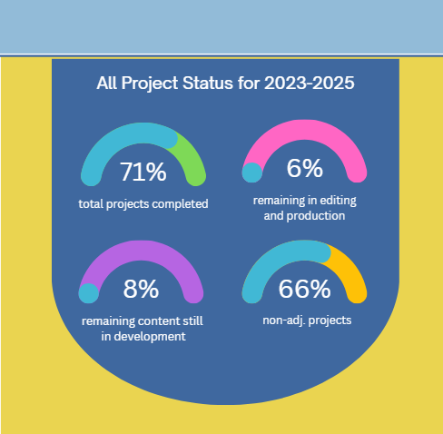
3. OP Projects – Status
All OP projects can be viewed on our website:
https://openpress.trubox.ca/projects/.
Notes:
2023-2025 Project Updates (Dani Collins)
Completed projects, carryovers, and new submissions

Slide 7
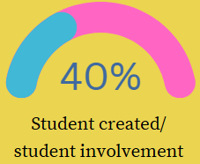
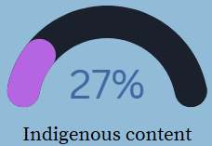
3. OP Projects – Status
OP 2025-2026 Adjudicated Projects
Fundamentals of Nursing Pharmacology - 2nd Canadian Edition – TBC January 2026 – School of Nursing
A Field Guide to Electrical Shock and Arc Flash Safety – TBC February 2026 – TRADES
Foundations of Mathematics 12 Workbook – TBC February 2026 – ABE – Faculty of Arts
Anesthesia Assistant Virtual Simulation – TBC November 2025 – Open Learning/ OL Media
CEL Resume Catalogue - Expansion – TBC November 2025– Career and Experiential Learning (CEL)
Utamaduni Bora/Indigenous stories - Completed October 2025 - Faculty of Social Work and Education
Introduction to Ethics and Great Thinkers: PART II – TBC February 2026 – Faculty of Arts
Indigenous Medicines of the Cayoose Creek Band in Sekw’el’was” [Phase II] – TBC February 2026 – BIO Chemistry – Faculty of Science
Research Methods in Criminology: An Inclusive Canadian Open Education Resource – TBC September 2025 – Criminology – Faculty of Arts - collaboration with Kwantlen Open Press
PASS Chem Case Study Learning Scenarios Collection – TBC February 2026 – CHEM – Faculty of Science
Enzyme Tales – Completed June 2025 – BIO Chemistry – Faculty of Science
Notes:
2023-2025 Project Updates (Dani Collins)
Completed projects, carryovers, and new submissions

Slide 8


3. OP Projects – Status
NON-ADJUDICATED PROJECTS
Future Earth Student Journal - Peter Tsigaris
  Volume 1, Issue 1 published - 5 articles
  Special Issue published
  New ISSN and DOI numbers
CTS Conference Proceedings - OJS journal
PLAR Guidebooks and Decolonization OER
Arts Cohort - ISP
Plumbing Level 1 - TBC Spring 2026
  ﻿ ZTC program!
  All BC Trades institutions!
Open Learning OERs
  Organic Chemistry (CHEM 2223)
  Psychology (PSYC 3261/3271)
Honours College - ISP - On hold
OP Website updates & Promotion!
Critical Thinking (Psychology) – Near completion - TBC December 2025
Notes:
2023-2025 Project Updates (Dani Collins)
Completed projects, carryovers, and new submissions

Slide 9
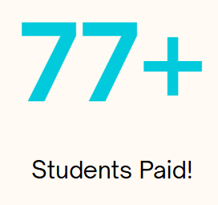
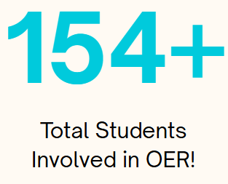
3. OP Projects – Students
8/11 adjudicated projects with student roles
(2025-2026)
  13 RAs
  1 project entirely student-led! (OE Global award winner!)
  32 student roles include reviewers, actors, content developers
Co-op positions with OP (3/term)
  Copy Editor/ writer: Impact interviews and stories (on OP website with project descriptions)
  2 E-learning Support Technicians
  11 TRU-OP Co-op students hired to date!
Notes:
2023-2025 Project Updates (Dani Collins)
Completed projects, carryovers, and new submissions

Slide 10
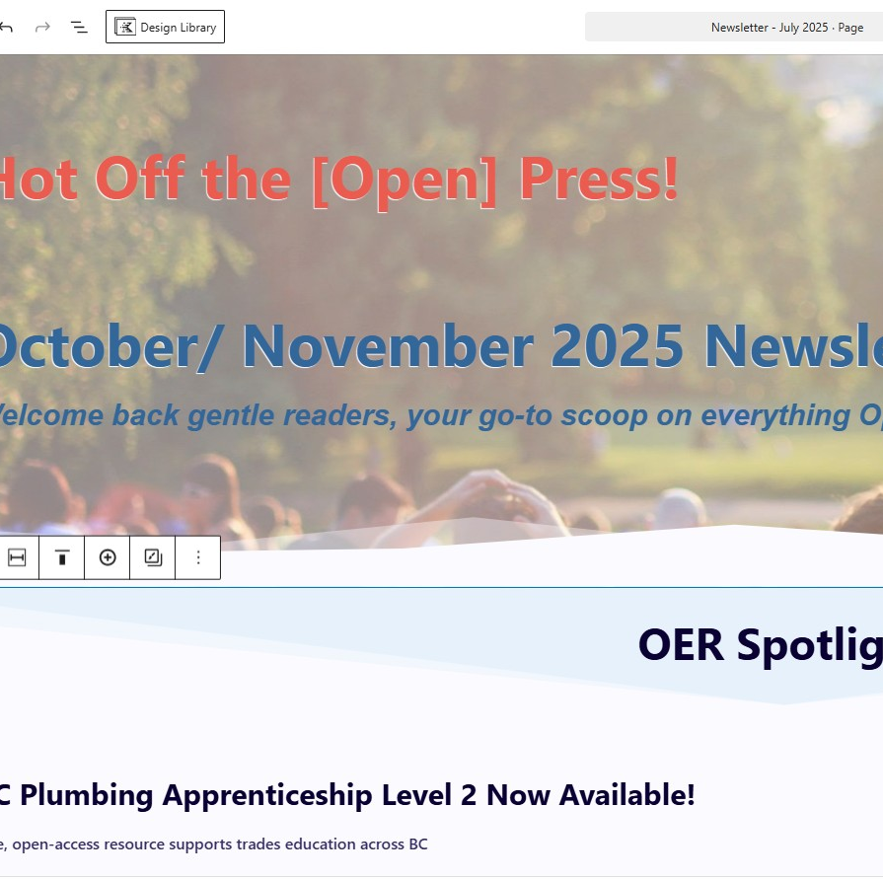
4. Promotion & Awareness Campaigns
Project Developer Interviews – 9
Impact Summaries and Stories - 9
Community of Practice platforms (OEWG, OEGlobal, B.C. Open Education Community (BCOEC), BCcampus - 34 on OER Commons
Old Main Open Table Events - September and October 2025
Presentations: TPC & Open Ed Talks
OP Website Updates (continuous)
TRU Library/ TRU Space - WIP
Hot off the (Open) Press!: October Newsletter
TRU OpenPress Socials:

Slide 11
Project Developer Interviews
https://openpress.trubox.ca/2024/04/26/simulated-client-records/
https://openpress.trubox.ca/2025/02/14/great-thinkers/
Impact Summary
Used in course(s): CHEM 1500, CHEM 1510, CHEM 1520
When: Fall 2024- Present
Estimated number of students using textbook(s): Exposure to 300 students per term–total across courses 700 per year (anecdotal evidence also suggests these students continue visiting the resources after the course is completed)
Average price of textbook replaced:
  Our resource is not replacing a textbook, our first-year chemistry textbook is an OER (Thompson Rivers University – Chemistry LibreTexts). OER textbooks are lacking practice problem solutions, so our resource was developed to fill that gap.
  When we had a traditional textbook that students purchased, the solutions manual cost would have been in the order of $50-100.
  Online resources for homework practice are in the range of $40 per semester.
  Textbooks with online homework are around $70 for 18 weeks access.
Estimated savings: $40-$70 x 300 students = $12000 – $21000

Slide 12
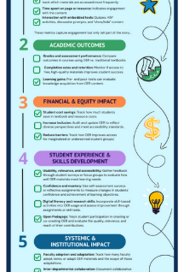
5. Data Collection and Impact Reporting
STILL Collecting data (IPE and TRU Library assist):
Number of TRU courses using OER
Total student enrollments in OER-supported courses – The number of students benefiting from OER in their courses.
Number of faculty adopting OER – Faculty members integrating OER into their teaching.
Number of student contributors – Students involved in creating, adapting, or reviewing OER.
Engagement metrics – Data on student interaction with OER, such as page views, downloads, or participation in interactive elements.
Number of ancillary materials developed – Supporting resources like H5P activities, quizzes, instructor guides, or multimedia.
Retention and success indicators – If available, data showing the impact of OER on student grades, course completion rates, or persistence.
Notes:
OER Impact Data (Dani Collins)
Adoption metrics, survey insights, usage statistics.

Slide 13
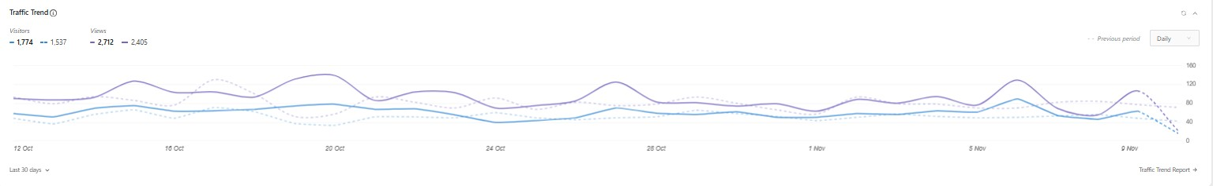
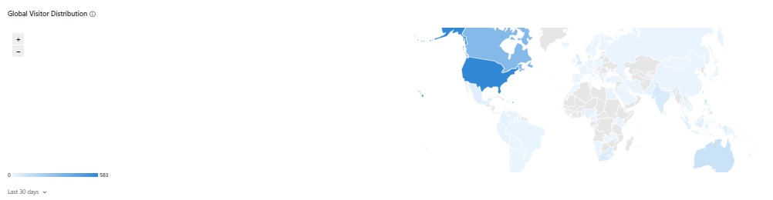
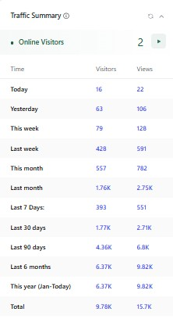
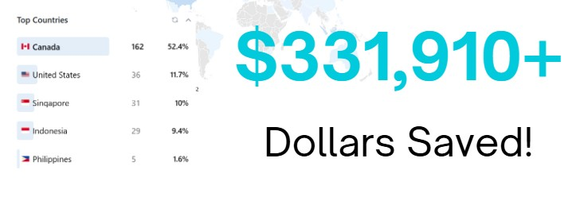
Impact Statistics
Resource usage
Learning gains
Cost savings
Faculty adoption
Participation in open pedagogy

Slide 14
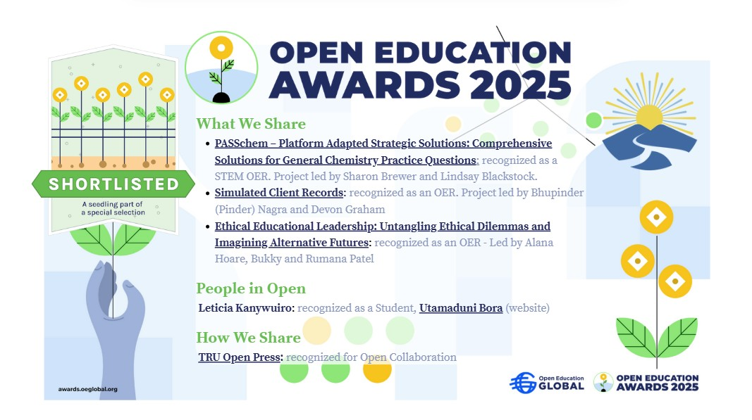

Slide 15
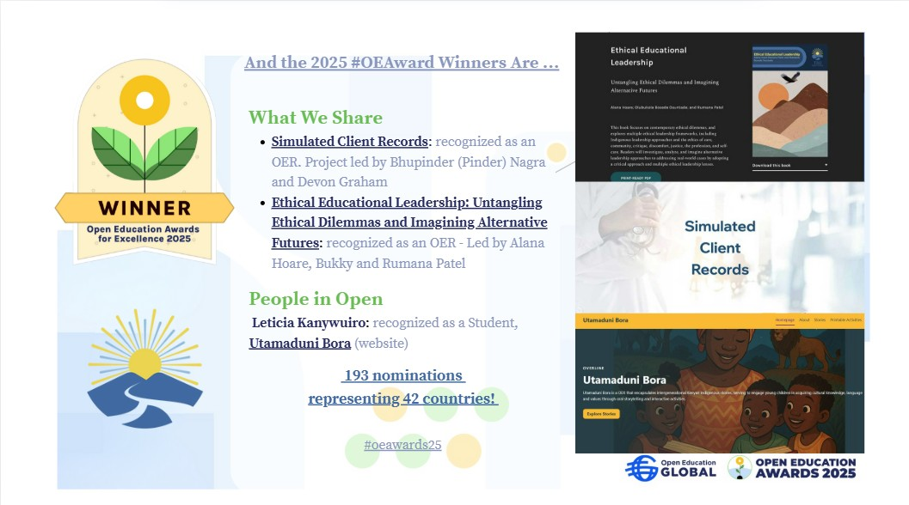

Slide 16

OPerations
Content Development to be developed by end of year (December 2026)
Invoicing for faculty and PSA (external subject matter experts) to be processed by end of February
Copy editor position – Kaitlyn has moved to a new position (external) – may hire a contract editor, if feasible/ practical
Production – Jessica may be looking for another position, which will leave the Publishing Manager and Co-op students
Hiring co-op students for last term (Jan-Mar 2026) tentative

Slide 17

8. Open Discussion & Q&A
    With Open Press concluding in March 2026, what strategies should we prioritize to ensure the continued growth and support of Open Education and OER development at TRU?
Notes:
Open floor for board members.
Potential new collaborations or project ideas.
Suggested Image: Team discussion or brainstorming session.

Slide 18
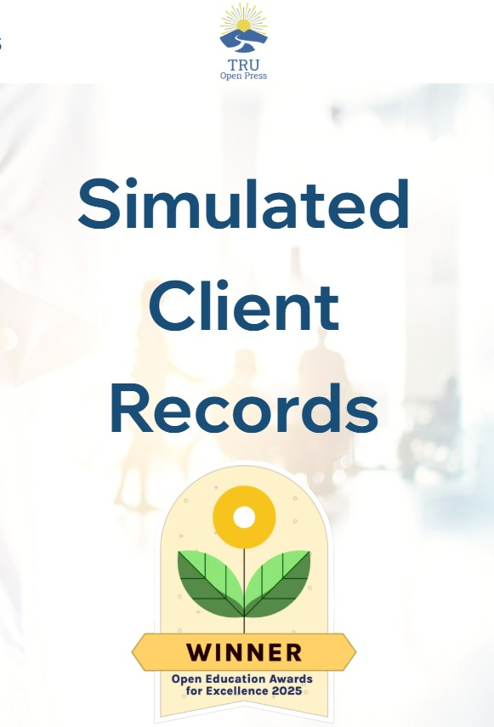
9. Action Items Review and Next Steps
  Note: Action items from February meeting still in progress
    In person student event @ Research Hub? (Sukh)
    Archive OER (Brenda & Dani)
    Planning for post 2026 sustainability (Brian and Marie)
    Next OP Advisory Board meeting – February 2026?
Notes:
Recap of key action items.
Assign responsibilities and set next meeting date.
Suggested Image: Checklist or task management visual, calendar with next meeting date.
Submission to other collections?

Slide 19
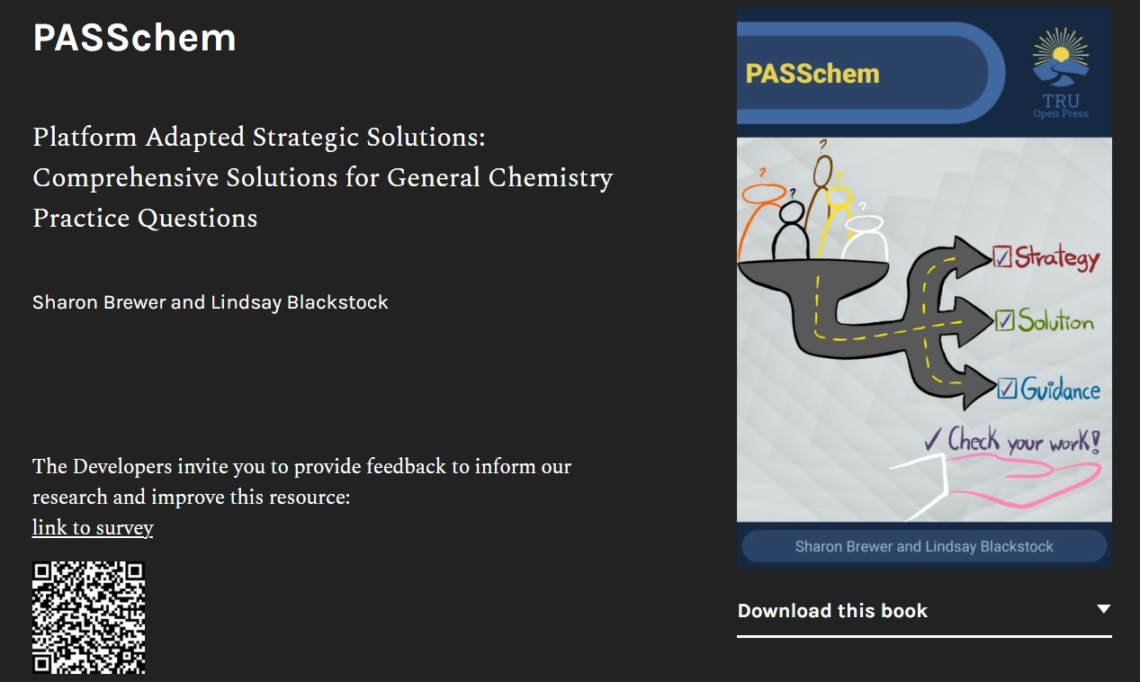
10. Adjournment & Closing Remarks
Notes:
Thank attendees for their contributions.
Thank you for your dedication and commitment to advancing the mission of TRU Open Press!
Suggested Image: "Thank you" slide with TRU branding or a teamwork visual.

