Slide 1




From Practice to Possibility
Faculty Voices on Open Education
THOMPSON-OKANAGAN TEACHING AND LEARNING CONFERENCE
Room HL 190 | Hosted by CELT
Thank you to TOTLC sponsors:
Notes:
Get ready for a dynamic conversation about the power of open education!
We’re bringing together four incredible panelists — plus one fabulous moderator — for a lively session on how open practices are transforming teaching and learning at TRU and beyond.
Let’s meet the minds behind the movement!

Slide 2



EXPLORE
ENGAGE
EMPOWER
INNOVATION
OER
INCLUSIVE
STUDENT-CENTERED
IDEAS
OPEN EDUCATION PRACTICES
TEACHING
PRACTICE
OPEN
DESIGN
COLLABORATION
LEARNING
EMPOWER
SUPPORT
CREATION
PRACTICES
OPEN EDUCATION RESOURCES
EXPLORE
Notes:
Open Educational Practices — or OEP — go far beyond free textbooks.
They invite us to explore bold ideas, engage in meaningful collaboration, and empower learners in every classroom.
Through open teaching, inclusive course design, and the creation of open educational resources, OEP supports student-centered learning that adapts to diverse needs and voices.
It’s not just about access — it’s about transformation.
OEP opens the door to more equitable, creative, and connected education.
Let’s dive into what that looks like in action — with the amazing educators leading the charge right here at TRU.

Slide 3
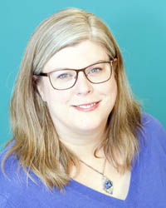
BRENDA SMITH Moderator
Open Education Librarian, TRU
Brenda supports faculty in adopting, adapting, and creating OERs that increase access and reduce student costs.
Notes:
Leading the way is Brenda Smith — our brilliant moderator! Brenda is an our very own open education Librarian with a big heart for open practices and student-centered learning. She’s the perfect guide for this exciting journey through open education possibilities.

Slide 4
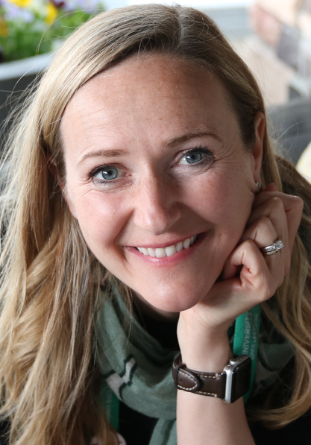
Marie Bartlett Panelist
Instructional Designer, TRU Open Learning
Marie helps instructors integrate open practices into course design to foster equitable, student-centered learning.
Notes:
Our first panelist is the one and only Marie Bartlett! Marie’s an instructional designer with a flair for creative pedagogy and inclusive design. She’s been championing open educational practices for years — helping faculty dream big and design even bigger. If you’ve ever wondered how open design meets real-world teaching, Marie’s your go-to gal!

Slide 5
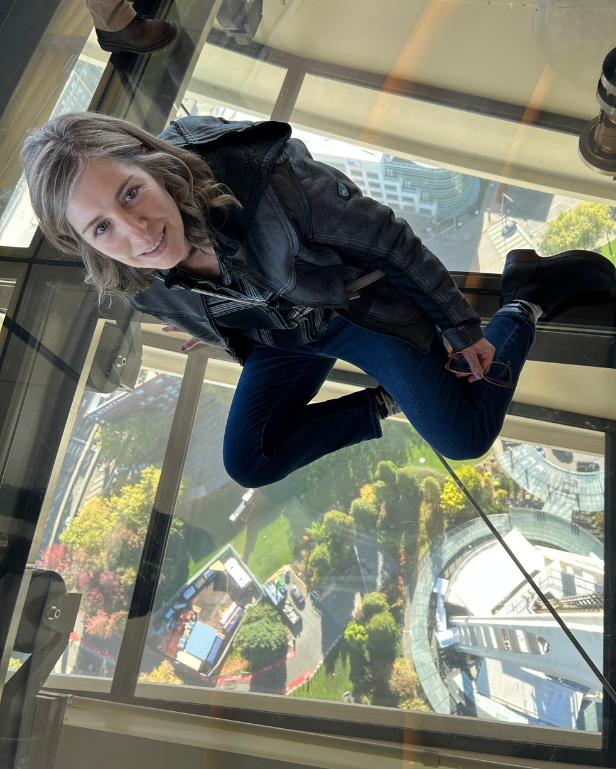
Jamie Drozda – Panelist
Educational Technologist, LT & I group, TRU
Jamie connects pedagogy and technology through accessible digital tools that support open learning environments (Moodle, Pressbooks, etc.).
Notes:
Now let’s talk tech—with Jamie Drozda from TRU’s Learning Technology & Innovation group! As an Educational Technologist, Jamie’s the magic behind connecting pedagogy with accessible digital tools. From Moodle to Pressbooks, she champions open, inclusive learning environments that just work—for everyone.

Slide 6
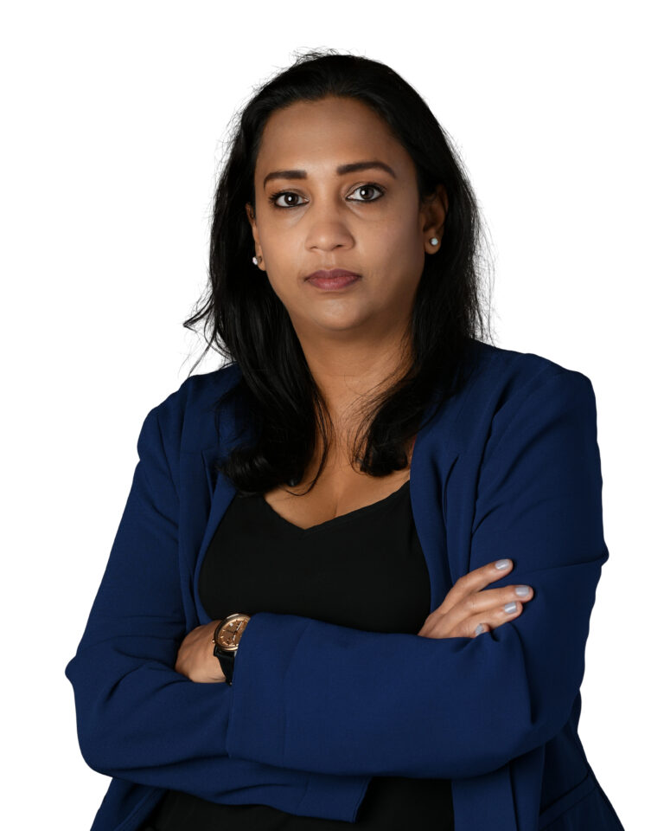
Natasha Ramroop Singh
Panelist
Faculty, Biological Sciences, TRU
In addition to teaching several courses at TRU, Natasha developed several OER textbooks and learning resources and is currently leading several new open projects in collaboration with TRU Open Press.
Notes:
Say hello to Natasha Ramroop Singh — powerhouse of the Biological Sciences and an OER legend! She authored the open textbook Introduction to Genetics — a game-changer for students diving into Punnett squares, probability, mono and dihybrid crosses and DNA. And she’s just getting started! Natasha’s cooking up more amazing open projects with TRU Open Press. Stay tuned… it’s gonna be double helix-level awesome!

Slide 7
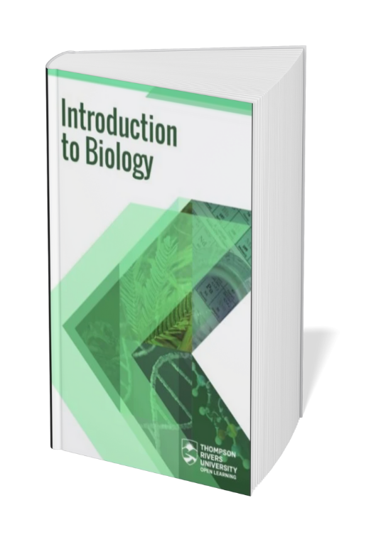


Notes:
One of Natasha’s TRU Open Press projects: no audio for this slide – can be shown with previous audio - TRU Open Press project

Slide 8

Notes:
One of Natasha’s TRU Open Press projects: no audio for this slide – can be shown with previous audio - TRU Open Press project

Slide 9
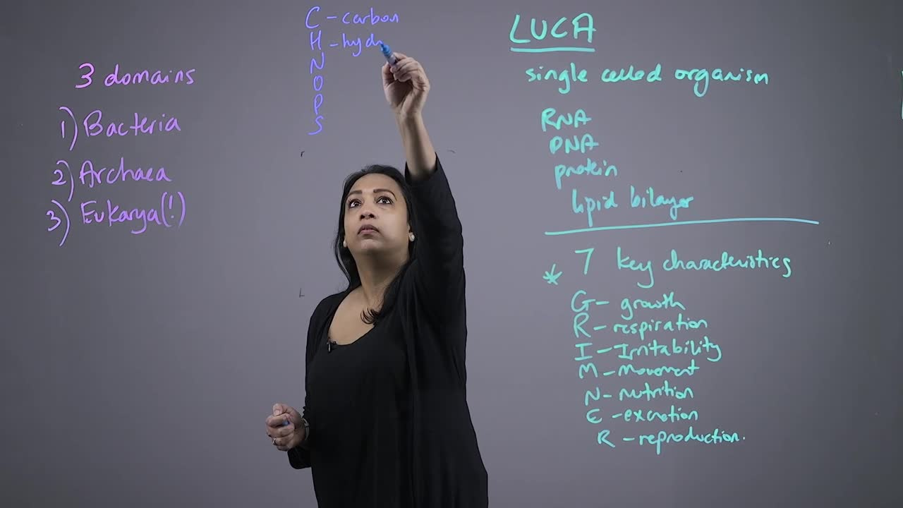
Notes:
Would love to have this playing (no sound) during previous audio for Natasha (starting on her introductory slide)

Slide 10

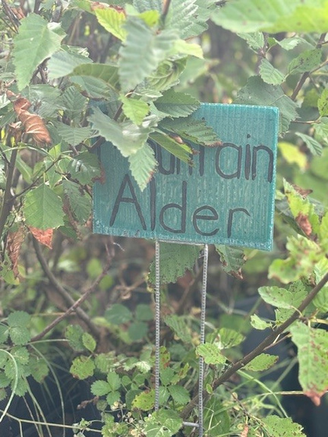
Notes:
Another one of Natasha’s TRU Open Press projects: no audio for this slide – can be shown with previous audio - TRU Open Press project

Slide 11
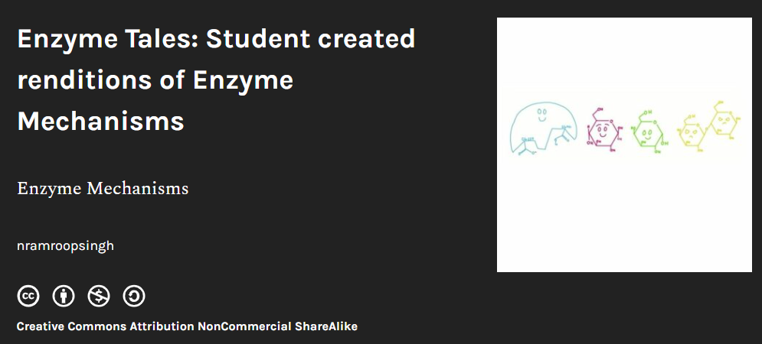
Notes:
Another one of Natasha’s TRU Open Press projects: no audio for this slide – can be shown with previous audio - TRU Open Press project
Can we try to animate the little enzyme characters?

Slide 12
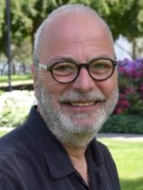
Peter Tsigaris – Panelist
Faculty, Economics, TRU
Peter is the author of several climate economics OER books (co-authored with students) with support from TRU Open Press and Editor-in-Chief for
Future Earth Student Journal.
Notes:
Our final panelist is Peter Tsigaris! Peter teaches Economics with a twist — open, accessible, and driven by real-world impact. He’s created not one, but three fantastic OERs with support from Open Press, making economics easier to access — and more fun to learn. From climate change to consumer choice, Peter’s showing us how open education fuels deeper understanding. He also launched the Future Earth Student Journal, supporting student voices on sustainability through open publishing.

Slide 13
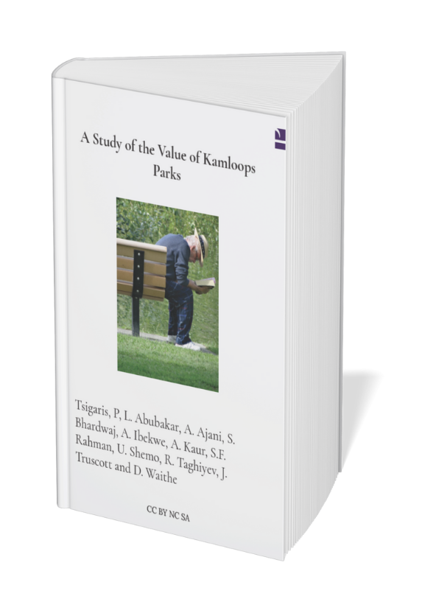
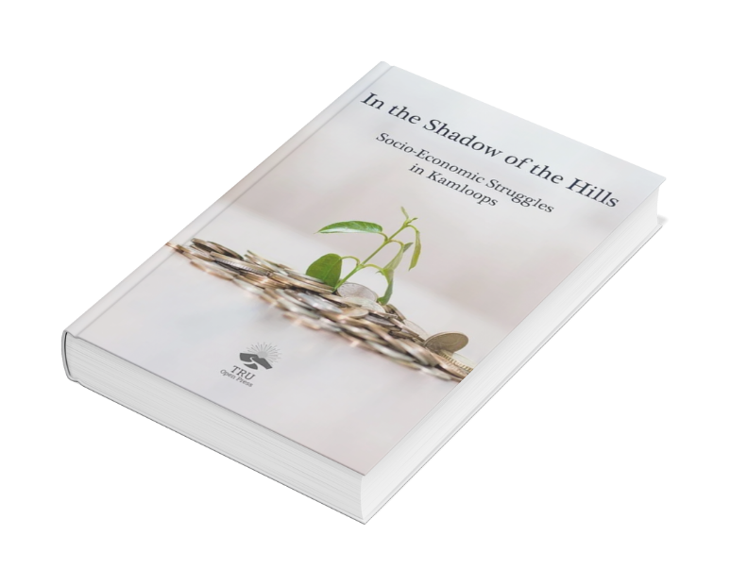

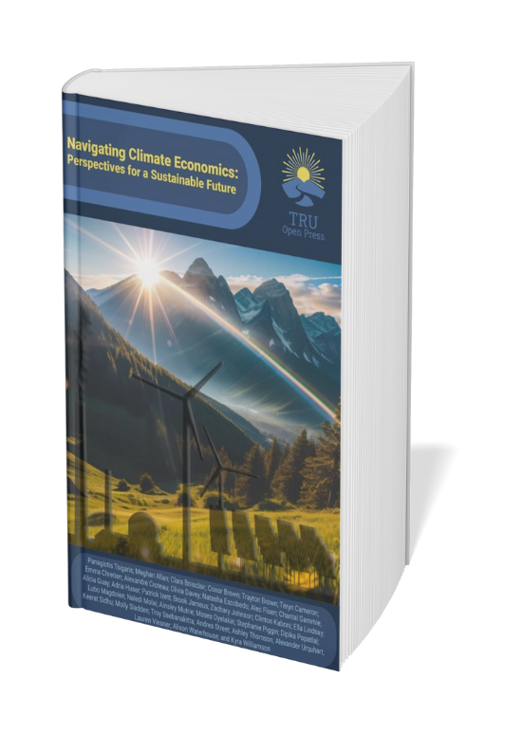
Notes:
Please have books fly in in the order from back to front that they are in right now (with Navigating climate…sitting on top).

Slide 14

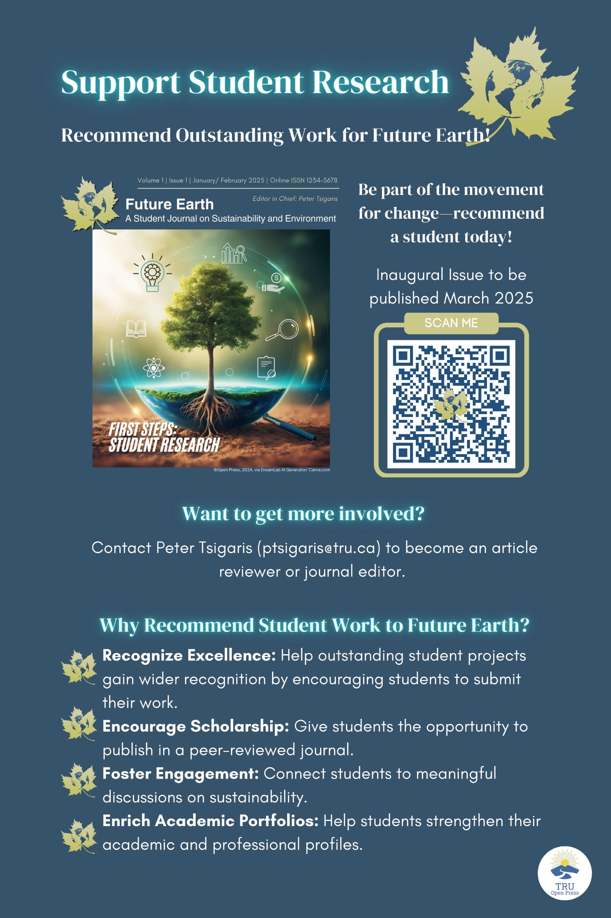





Slide 15
Notes:
Each panelist brings a unique lens to the open education movement — from classroom innovation to digital empowerment and textbook creation.
Join us to hear their stories and discover how openness can shape the future of teaching and learning.

Slide 16


Thank You!
This panel is proudly supported by TRU Open Press.
Learn more at openpress.trubox.ca
Notes:
We’re so glad you’re here!
This panel video introduction was proudly supported by TRU Open Press — your partner in creating and sharing open educational resources that make a difference.

