Slide 1
Celebrating Success
Over 35 TRU Open Press Projects
Transforming Education for Thousands of Students
Open Education Talks 2025 | March 12, 2025 | Thompson Rivers University
Notes:
Hello everyone, and welcome! Whether you’re joining us in person or online, we’re so glad to have you here and grateful for the opportunity to tell you a little about ourselves and more importantly the Open Education Resources and Pedagogy projects that we’re supporting.
In the next 15 minutes, I’ll give you a brief introduction to TRU Open Press—our open publishing initiative dedicated to creating free, accessible, and high-quality learning resources. After that, I’ll turn it over to the amazing Open Press team who will share their experiences working with Open Press and highlight some of the exciting projects we’ve been involved in. Let’s get started!

Slide 2
RESPECT | RECIPROCITY | BALANCE
EXPLORATION | DISCOVERY | STEWARDSHIP
Notes:
But first…We want to acknowledge that Thompson Rivers University is located on the unceded territory of the Secwépemc Nation. We recognize and respect the Secwépemc people, who have cared for this land since time immemorial. As we discuss Open Press and open education, we commit to fostering learning that is inclusive, accessible, and reflective of Indigenous knowledge and perspectives. We are grateful to live, work, and learn on these lands and strive to support Indigenous values of respect, reciprocity, balance, exploration, discovery, stewardship and reconciliation through our work.

Slide 3
Introduction to Open Press
Initiated 2023 by Marie Bartlett and Brenna Clark Gray
TRU’s Open [centralized] Publishing Hub
✅ High-Quality
✅ Free
✅ Accessible
Removing Barriers to Learning - linked to TRU’s Strategic Plan
Supporting Students and Faculty
Global Impact
Team
1 Publishing Manager, 1 copy editor, and 1 e-learning support technician
Co-op students: 2 ELSTs and 1 Copyeditor/ writer
openpress.trubox.ca
Notes:
We’re excited to introduce you to TRU Open Press, an initiative that’s transforming how we create and share knowledge at Thompson Rivers University. I feel incredibly fortunate and humbled to be doing this work!
So, what is Open Press? It’s TRU’s open publishing hub, dedicated to developing high-quality, free, and accessible educational resources. Our mission is simple: remove barriers to learning by creating Open Educational Resources (OER) that benefit students, faculty, and the global learning community.
We’re now entering Year 3 of a 3-year initiative, originally proposed by Marie Bartlett and Brenna Clarke Gray and approved and funded by the Provost as part of TRU’s Strategic Plan. Open Press was created to serve as a centralized OER publishing hub, ensuring that OER development isn’t an extra burden for faculty to manage on their own. Instead, we provide expertise and support in one place, building on TRU’s strong foundation in open education since 2007. We work closely with Learning Technology and Innovation, TRU’s Open Education Working Group, Open Learning’s Media and Production teams, and we utilize many of the resources provided by BCcampus to offer expert guidance and technical support.
At its core, Open Press is about:
✅ Creating/ adapting and adopting high-quality, free, and accessible learning materials for all
✅ Removing barriers by reducing costs and increasing access to learning and learning materials
✅ Supporting students and faculty with creating adaptable, innovative resources
✅ Making a global impact by sharing and disseminating TRU’s research knowledge with the world through openly licensed resources

Slide 4
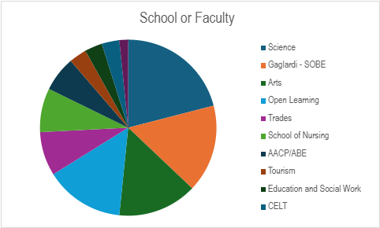
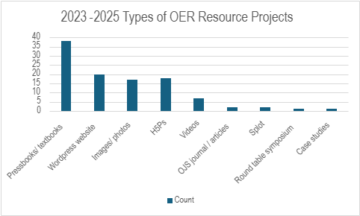
Project Overview
Completed: 18 projects
In progress: 35 projects
Adjudicated projects from 2024 —>
736 students and 63 faculty impacted
20,000 unique visitors from around the world
Supports provided from Open Press team:
site/ domain set up/ structure/ design
importing content to platform
copy editing
copyright review for 3rd party materials (all openly licensed)
images/ videos
accessibility and attribution standards
support for other departments and ISP (OEP/ OER) initiatives
promotion
Notes:
Since its launch, Open Press has grown far beyond expectations. Just in Year 2:
18 projects completed, with 35 more in progress
736 students and 63 faculty directly impacted
Over 20,000 unique visitors from around the world accessing TRU’s OER - Jessica will talk more about some of the stats later on.
Our OER projects span every TRU faculty, from Arts to Trades, Nursing to Science, and include interactive H5P materials, video resources, and even student-led projects. We’re not just publishing books—we’re building a movement!
The types of projects vary, with textbooks being the majority, closely followed by websites on Wordpress, H5Ps and videos, and images/ photos. The supports provided by Open Press has predominantly included site domain set up, structure and design and copy editing, but as Kaitlyn will describe later, we’ve been able to use resource guides for copyright/ attribution and accessibility standards that have been already developed by TRU and BCcampus, which has helped immensely.

Slide 5
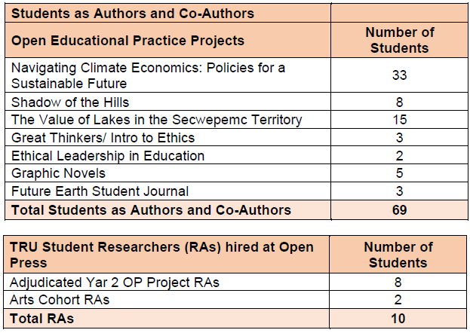
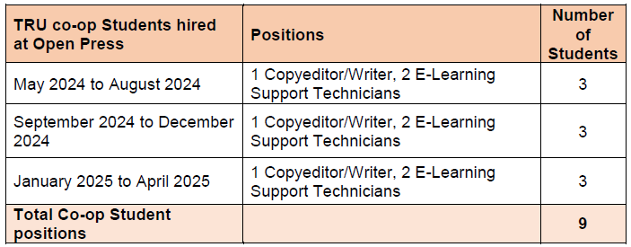
Student Involvement & Innovation
Notes:
Students are at the core of Open Press, actively shaping its success. Over 80 students have contributed as researchers, content creators, and co-authors. Many gained hands-on experience with Pressbooks and WordPress, learning accessibility, copyright, and technical skills while collaborating with faculty to develop OER content. As we’ve heard from Aiko’s project interviews and impact stories (more from Aiko later), co-creating OERs is a rewarding experience for students - it’s the gift that keeps giving for many. Many faculty also beta-tested their OERs over a term and we helped them to implement student feedback into their OERs afterward.
Student leadership has been essential—three TRUSU representatives have served on our Advisory Board, offering valuable student perspectives. At their suggestion, we hosted in-person OER info sessions and conducted a student survey with 58 participants, highlighting the need to further raise awareness and advocacy for OERs.
From the beginning, Marie and Brenna built co-op student opportunities into Open Press, providing experiential learning in OER publishing. We’ve been lucky to work with incredibly talented students like Aiko, Vansh, and Jesse!
Note about RAs: 8 + 10 = 18 total

Slide 6
Estimated Cost Savings for TRU Students
Based on average textbook cost $100/textbook across all disciplines
High quality, resources with supplementary materials
Numbers are likely underestimated
Planning on getting more accurate numbers during year 3
Notes:
One of the biggest impacts of Open Press is student cost savings. By using OER instead of commercial textbooks, we estimate that TRU students have saved $150,000 over the past two years. This is based on an average textbook cost of $100 per student per course, though the actual savings may be even higher.
Tracking OER adoption is challenging, but we’re working to improve our data collection. We’ve added feedback forms to our resources and are monitoring web traffic, which shows thousands of visitors worldwide accessing TRU’s OER. As we move into Year 3, in addition to better promoting our completed projects, we’ll continue refining our data to better measure OER’s growing impact!

Slide 7
Impact Story
Key Quotes
Inclusivity:
Ensuring access to high-quality flexible learning materials for students from diverse backgrounds
Affordability:
Reducing financial barriers with free, open resources
Empowerment:
Enabling students to improve and perform better through enhanced skills and confidence.
Collaboration:
Driving feedback-driven development, supported by the TRU Open Press
“We can adjust, change, add, or take out things as needed. These resources will definitely save students’ study time…They are able to better focus, save time and perform better in exams through proper interpretation of questions.” ーNatasha Ramroop Singh (Essential Chemistry for Biologists: Decoding the Language of Life)
“LINKAGE is about connecting nurses.”
ーNoopur Swadas (LINKAGE)
“The whole idea for this project is to increase student abilities and student success and confidence.” ーSharon Brewer and Lindsay Blackstock (PASSChem)

Slide 8
Jesse's Co-op Experience
Background
BCS & BBA (3rd Year)
Role
E-Learning Support Technician
Projects I’ve Contributed to:
Plumbing Apprentice Level 1 Textbook
Arts Cohort Website Creation
Ethical Educational Leadership Website Redesign
IJEDE - Word to HTML Transcript Automation
Key Takeaways
Learned how to manage multiple projects in a work environment
Developed my Wordpress and Pressbooks skills
Gained hands-on experience with the project development lifecycle
Notes:
Hello everyone, my name is Jesse Perkins, and I’m currently in my third year of a double bachelor’s degree in Computer Science and Business Administration. This semester, I’ve been working as an E-Learning Support Technician for the Open Press team where I’ve contributed to several ongoing projects. This experience has not only enhanced my web development skills but also provided valuable insight into the project development lifecycle. Throughout my co-op I’ve gained practical skills in project and task management, web development, and business strategy, which I’ll be able to bring with me to future roles.

Slide 9
Vansh's Co-op Experience
Background
BCS (4th Year)
Role
E-Learning Support Technician
Projects I’ve Contributed to:
Plumbing Apprentice Level 1 Pressbook
Interactive Health Education Game (LINKAGE Project)
H5P Presentation (LINKAGE Module)
Algebra Essentials Website Redesign
Key Takeaways
Gained hands-on experience in WordPress & Pressbooks.
Gained experience in project planning and requirement gathering.
Developed strong teamwork skills to manage projects effectively
Notes:
Hello everyone, My name is Vansh Sethi, and I’ve been working as an E-Learning Support Technician for TRU Open Press for this semester. During my time here, I’ve contributed to various ongoing projects that have strengthened my web development skills and increase my experience with e-learning tools. Beyond the technical side, this co-op has helped me grow in collaboration, teamwork, project planning, and requirement gathering to fully meet the Stakeholders’ expectation. These skills are invaluable for me in my future career path .
Working at TRU Open Press has been an incredible experience. What motivates me to do my job is that I am able to contribute to the amazing mission of making education more accessible to students through open educational resources. Also, what truly made this experience special is the team—supportive, innovative, and always open to new ideas. I feel grateful for this opportunity and excited to carry these skills forward in my career.

Slide 10
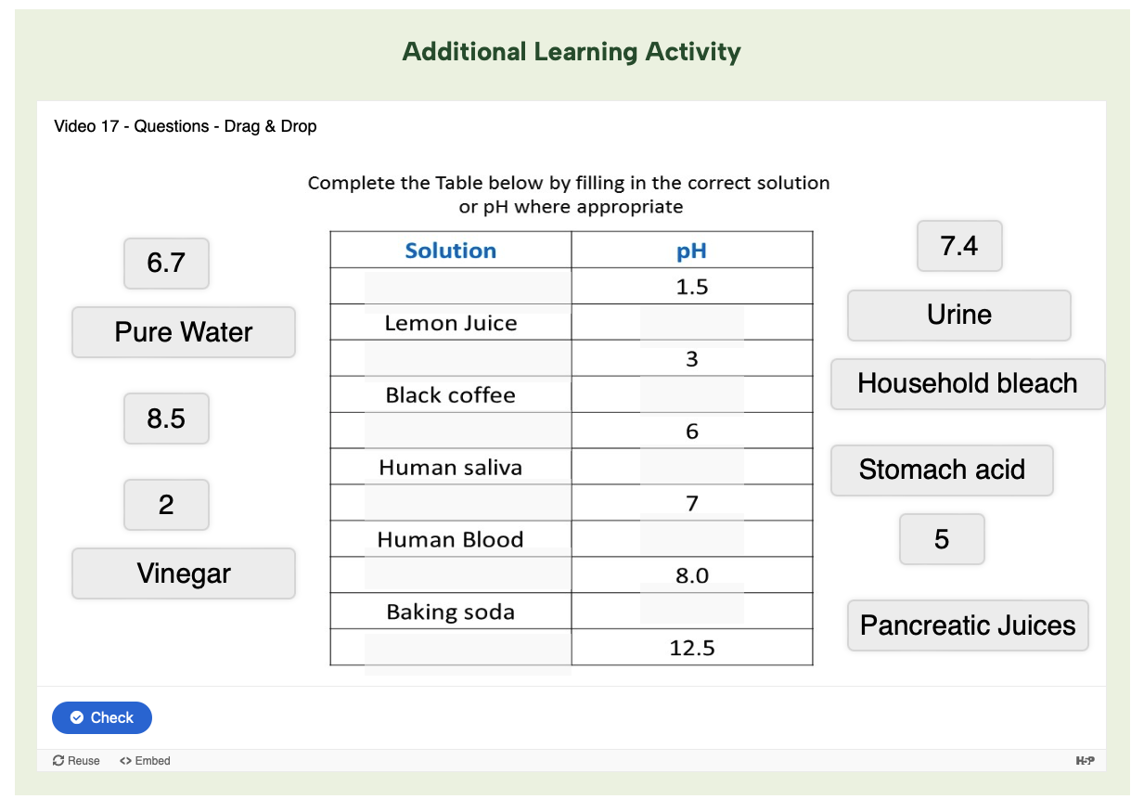
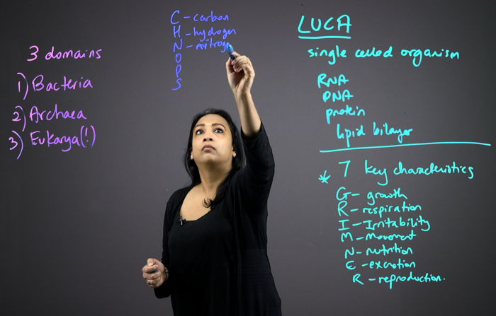
Essential Chemistry for Biologists
By Natasha Ramroop Singh
This website contains 20 short videos designed to explain basic but important concepts in chemistry to university students in entry-level biology.
Features
Lightboard videos
Interactive activities
Statistics
Technical Support
Domain Setup
Layout and Design
Plug-ins
Feature development
https://chemistryforbiologists.trubox.ca/
Notes:
1min - Hello! My name is Jessica, and I’m part of the production team as an E-learning support technician at TRU Open Press. In the next few slides, my teammate Kaitlyn and I will walk you through some of the projects we've worked on so you can get a better idea of how we assist during the development process.
First, we have the Essential Chemistry for Biologists project by Natasha Ramroop Singh. This is a website that features 20 videos designed to explain chemistry concepts to biology students.
Some of the key features of the site include lightboard videos where Natasha explains the concepts, and before watching the videos, students can test their knowledge. They can also take the quiz again after watching to see how much they've learned. Additionally, some of the videos include interactive activities we developed with H5P, such as crosswords, hotspot images, drag-and-drop exercises, and more.
In terms of technical support, we helped with domain setup by assisting the user in selecting their domain name. We also worked on the basic layout and design of the website, ensuring it followed the desired structure. Additionally, we implemented plugins, set them up, and developed other features to enhance the project.

Slide 11
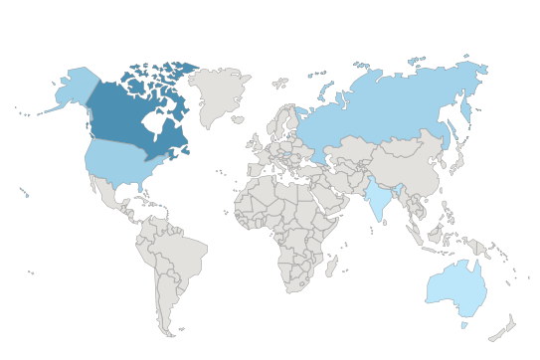
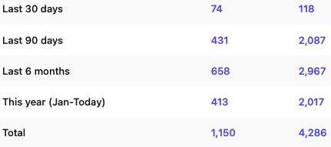
User Engagement
Statistics
Pre and post video activities
Number of Views & Entries
Conversion Rate (%)
Quiz Entries
Total Scores
Website statistics
Visitors
Most Visited Pages
Traffic Trends
And more…
Notes:
50sec - On most of our websites, we’ve implemented features that allow us to gather valuable quantitative data, such as the number of visitors, most visited pages, and traffic trends. This data helps us understand when users tend to access the site and gives us insights into how impactful these open educational resources are.
For the Chemistry for Biologists project, we added a special feature to get the metrics of the pre- and post-video activities. This allows us to measure the impact of the videos by comparing quiz scores before and after the users watch the content, showing how effective the videos are in increasing knowledge.
Next my teammate Kaitlyn will talk to you about another project.

Slide 12
Ethical Educational Leadership
by Alana Hoare, Rumana Patel, and Olubukola Bosede Osuntade
This accessible textbook explores multiple ethical leadership frameworks and how they can be applied to real-world cases.
Significance
Student researchers (Rumana & Olubukola)
Chapter with an Indigenous context
Ethical Dilemmas Roundtable Symposium + Report
Copy Editing Support
Standardizing formatting
Fixing syntax errors
Editing for clarity
Reviewing citations
https://leadershipethics.pressbooks.tru.ca/
Notes:
Hi everyone, I’m Kaitlyn and I’m the copy editor for the Open Press. Ethical Educational Leadership is a textbook by Alana Hoare. It explores multiple ethical leadership frameworks, including one Indigenous perspective, and how they can be applied to real-world cases. Alana worked with two student researchers, Rumana Patel and Olubukola Bosede Osuntade, to develop this book. After completing the first half of the book, Alana and the student researchers hosted an ethical dilemmas roundtable symposium that allowed members of the TRU community to critically explore real-world ethical dilemmas in higher education. Afterwards, they created a report based on this symposium.
So, what did the OP do to support them copy-editing-wise? On a basic level, we created a style sheet and used it to ensure that each chapter had standardized formatting, correct syntax, and correct citations. As well, we reviewed the entire text to ensure the information was presented as clearly as possible while still maintaining the author’s voice. Later on, we provided proofreading for the symposium’s report to ensure it matched the rest of the textbook.
As you can see from this project, we have streamlined the copy editing process with the resources we have created in advance, like our style sheet templates, as well as internet resources, like the APA style guide.

Slide 13
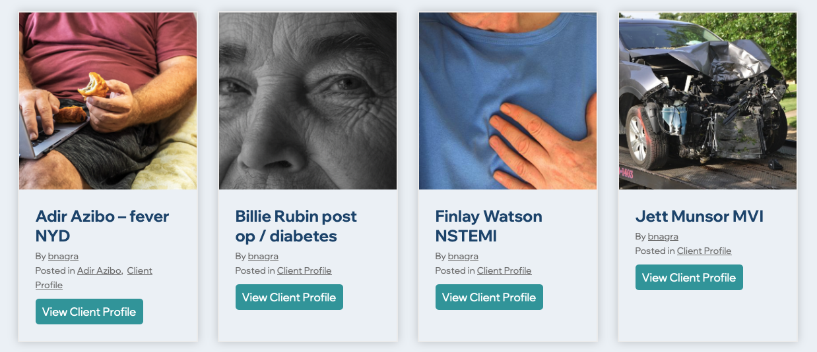
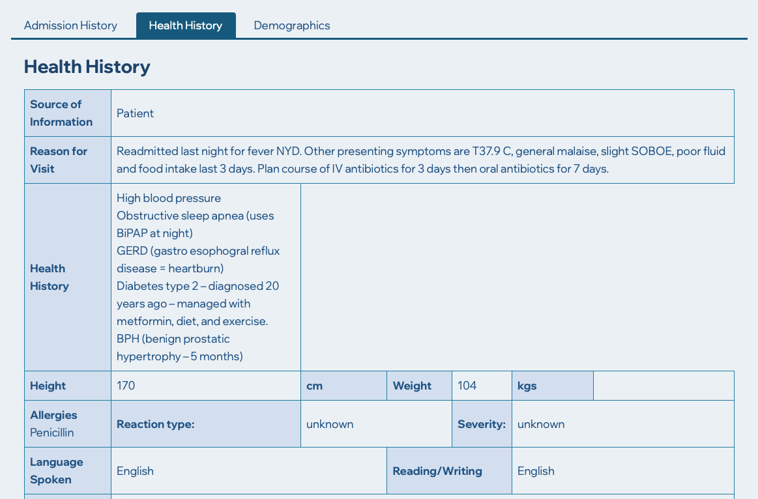
Simulated Client Records
By Pinder Nagra and Devon Graham
This site allows educators to access simulated electronic health records (EHR) for their classes. Provides a realistic and immersive learning experience for students.
Technical Support
Domain Setup
Layout and Design
Feature Development
User Training and Documentation
https://simulatedclientrecords.trubox.ca/
Notes:
1min - Next, we have the Simulated Client Records project by Pinder Nagra and Devon Graham. This is a website that allows educators to create, develop and use simulated electronic health records for their classes. The site provides a realistic learning experience for students, as it simulates the electronic methods they’ll use when they enter the workforce.
In terms of technical support for this project, we assisted with domain setup, helping the user select their domain name. We also worked on the basic layout and design of the website, ensuring it met the desired structure. Additionally, we implemented special features to match the required data chart style. Also, we provided training and documentation to the site admins to help them create more client records on their own moving forward.

Slide 14
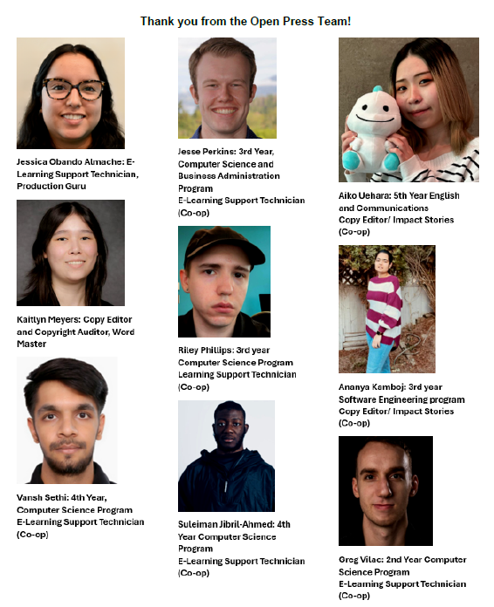
Thank you!
openpress.trubox.ca

