Slide 1
Celebrating Success
Over 35 TRU Open Press Projects
Transforming Education for Thousands of Students
21st Annual Teaching Practices Colloquium | February 18, 2025 | Thompson Rivers University
Notes:
Welcome, everyone!
Good morning and thank you for joining us today. My name is Dani Collins, and this is the Open Press team. I’ll let everyone introduce themselves briefly before we move on.
We’re excited to be here to talk to you about Open Educational Resources, or OERs, and the work being done at TRU Open Press.
This session will explore the impact that OERs can have on students, instructors, and institutions. We'll dive into some of the innovative projects we're developing, including resources aimed at improving student success in high-enrollment courses, and we'll discuss how you can get involved in shaping the future of open education.

Slide 2
RESPECT | RECIPROCITY | BALANCE
EXPLORATION | DISCOVERY | STEWARDSHIP
Notes:
I would like to acknowledge that we are gathered on the traditional and unceded territory of the Tk'emlúps te Secwépemc. We honor their deep connection to this land, and we are grateful for the opportunity to work and learn here.
As we explore Open Educational Resources today and the OER projects that we’ve been developing, it’s important to reflect on how this work aligns with the values of Indigenous peoples—values of exploration, sharing knowledge, community, collaboration, and accessibility. Like Indigenous worldviews, I feel that OERs and the work that we do emphasize the collective sharing and nurturing of wisdom, fostering greater inclusivity and respect in education for all.
Thank you for being part of this meaningful work today.

Slide 3
Agenda
Welcome & Introduction
What are OERs?
Impacts of OERs
Open Press Overview
Open Press Project Showcase
Call for Project Proposals (2025-2026)
Future Directions for Open Education
Conclusion & Q&A
Notes:
The agenda for today includes a brief overview of OERs and their benefits, a look at some of the exciting Open Press projects currently underway, and a call for new project proposals. There will also be plenty of opportunities for you to reflect and engage, so I encourage you to participate in the polls and ask any questions you may have as we go along.
Let’s get started!

Slide 4
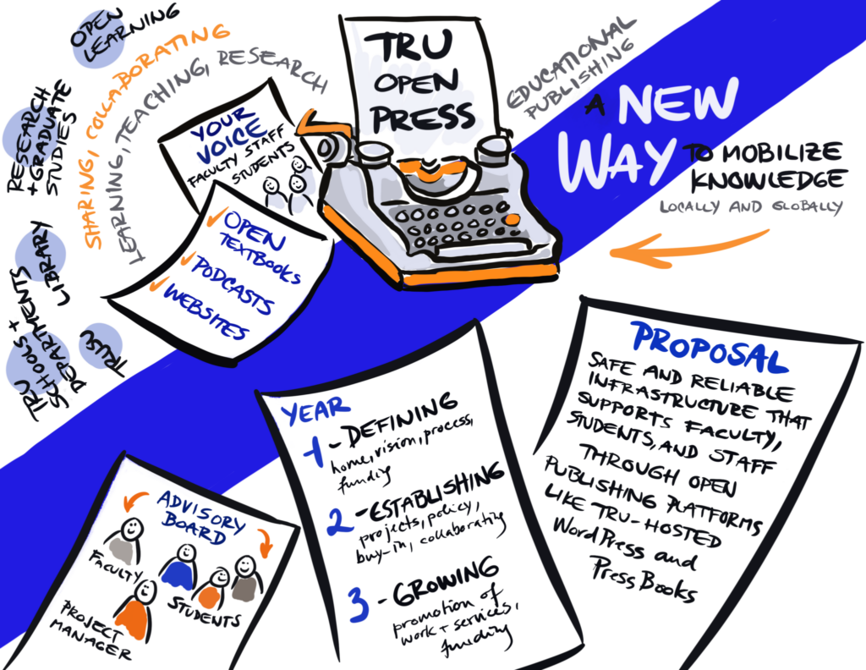
Introduction to Open Press
​
Mission: “[To] offer wrap-around supports for the creation and development of open educational resources, open scholarship, and open pedagogy projects.”
Notes:
Overview of TRU Open Press (2-3 minutes)
Open Press – What We Do
Founded in 2023, TRU Open Press is the result of long-standing advocacy for Open Education at Thompson Rivers University. With support from a 3-year Integrated Strategic Planning (ISP) grant, secured by former Open Education Working Group (OEWG) chair and vice-chair Brenna Clarke Gray and Marie Bartlett, the press was established to create a centralized hub of publishing expertise. TRU Open Press aims to support students and educators by developing Open Educational Resources (OERs) and promoting Open Educational Practices (OEPs), enhancing accessibility, affordability, and innovation in education.

Slide 5
Poll: How familiar are you with Open Educational Resources (OER)?
Notes:
Presentation objectives
Importance of open educational resources (OER) and the impact of TRU Open Press
Poll Question: “How familiar are you with Open Educational Resources (OER)?" (1-2 minutes, allowing time for responses) (1-2 minutes, allowing time for responses)
Options: Never heard of them | A little | Very familiar | Use them often

Slide 6
What Are OERs?
Free, adaptable teaching and learning materials
Textbooks, videos, quizzes…
Open Licensing
Modification and redistribution
Notes:
Open Educational Resources (OERs) are teaching, learning, and research materials that are freely available for use, adaptation, and redistribution. They encompass a wide range of media, including textbooks, videos, and course materials, and are generally disseminated under open licenses that facilitate modification and further sharing. You’ll get a better idea of what these might look like later when we showcase some of the amazing projects we’ve been lucky enough to support.
To gauge the level of familiarity with Open Educational Resources (OERs) among students and instructors, we conducted a survey from late October to January, utilizing various recruitment methods, including poster displays, in-person engagement, and incentives such as Halloween candy and a chance to win a coffee gift card to Common Grounds. The survey yielded 58 student responses and 7 instructor responses. The preliminary data presented in this chart underscores the need for continued efforts to raise awareness and understanding of OERs at TRU. Despite the university's longstanding commitment to supporting OER development, there remains a significant opportunity to further promote OERs and their potential benefits, particularly in light of ongoing challenges such as reduced funding, declining international enrollment, and other factors.

Slide 7
Poll: How familiar are you with Open Educational Resources (OER)?
Notes:
Presentation objectives
Importance of open educational resources (OER) and the impact of TRU Open Press
Poll Question: “How familiar are you with the benefits of OER for students?”(1-2 minutes, allowing time for responses)
Options: Very knowledgeable
General understanding
General understanding
Some knowledge
Little familiarity
Unfamiliar

Slide 8
Textbook Costs at TRU
54% of students did not purchase a required textbook at least once due to cost, and 27% took fewer courses as a result. (Jhangiani & Jhangiani, 2017, p. 178)
48% of respondents took fewer or alternative courses based on textbook costs (Senack, 2014, p. 12).
Notes:
Textbooks impose a heavy financial burden on students. The Canadian Federation of Students noted in 2011, before the global shift that happened after COVID, that textbook expenses typically ranged from $500 to $1,000 per semester, especially impacting engineering and applied sciences. This is likely more in 2025. For example, UBC’s current bookstore website reports averages of $400 for Arts/Commerce and $700 for Science courses—often even more without digital or used options that are now more available. Our TRU survey, as shown in this chart, confirmed that high textbook costs. Despite TRU’s commitment to Zero Textbook Cost initiatives and OER development with TRU Open Press and Open Learning, textbook costs are a significant issue, affecting students’ budgets and potentially even influencing course enrollment decisions. This underscores the urgent need for affordable alternatives like OERs, which offer high-quality, cost-effective resources that can ease this financial strain.
According to the Canadian Federation of Students, the average postsecondary student in Canada spends about $500 to $1,000 for textbooks and course materials each semester – with students in engineering and applied sciences usually hit the hardest – even in this day of the e-reader. https://www.theglobeandmail.com/globe-investor/personal-finance/household-finances/how-to-cut-the-cost-of-text
books/article600370/#:~:text=According%20to%20the%20Canadian%20Federation,day%20of%20the%20e%2Dreader. – 2011
Student Views on the Cost of and Access to Textbooks: An Investigation at University of Otago (New Zealand) - Open Praxis, vol. 9 issue 4, October–December 2017, pp. 403–419 (ISSN 2304-070X) https://files.eric.ed.gov/fulltext/EJ1165496.pdf
Jhangiani: This study surveyed 320 post-secondary students in British Columbia who used open textbooks during the Spring, Summer, and Fall semesters of 2015. The research examined students' textbook purchasing behaviors, the negative impact of textbook costs on their course enrollment, persistence, and performance, as well as their usage and perceptions of open textbooks. Findings indicated that over half of the respondents (54%) reported not purchasing a required textbook at least once due to cost, and 27% had taken fewer courses as a result. Additionally, 63% of respondents rated the overall quality of their open textbooks as above average or excellent.

Slide 9
Impact on Students
Cost Savings
Reduces or eliminates the need for textbook$
No access codes or supplementary materials – all included
Reduce financial burden, removes barriers
New editions
Notes:
Impact on Students (2-3 minutes)
Discuss the benefits of OER for students – survey or research data to support?
Visuals: Testimonials or success stories from students – pull some quotes from impact stories – show graph from Survey monkey about how much textbooks are costing our own students!
OER significantly reduce costs for students by eliminating the need for expensive textbooks, access codes, and supplementary materials. Traditional textbooks can cost hundreds of dollars per course, and frequent new editions make it difficult for students to buy used copies. OER provide free, immediate access to high-quality learning materials, ensuring that all students have what they need from day one. This financial relief allows students to allocate their resources toward other essentials like tuition, food, and housing, ultimately improving their academic success and well-being.
Beyond student savings, OER also benefit institutions and faculty. Colleges and universities can reduce costs associated with textbook subsidies and library purchases, while faculty gain the flexibility to customize course materials without copyright restrictions or licensing fees. Over time, widespread OER adoption leads to substantial, long-term cost savings across multiple courses and institutions, making education more affordable and accessible for all.

Slide 10
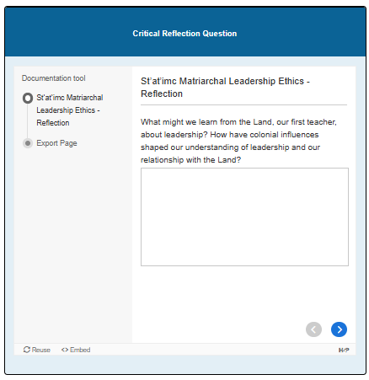
Impact on Students
Accessibility & Convenience
Anytime, anywhere, any device
Designed for accessibility: WCAG guidelines (alt text/ screen readers, colour contrast, audio, etc.)
Engagement
videos, simulations, and interactive exercises
Customized / Indigenized
Ethical Leadership in Education by Alana Hoare, Olubukola (Bukky) Bosede Osuntade; and Rumana Patel.
Notes:
Impact on Students (2-3 minutes)
Discuss the benefits of OER for students – survey or research data to support?
Visuals: Testimonials or success stories from students – pull some quotes from impact stories
Open Educational Resources (OER) significantly enhance accessibility by providing students with free, unrestricted access to learning materials anytime, anywhere, and on any device. Unlike traditional textbooks that may have expiration dates, paywalls, or access codes, OER remain available before, during, and after a course, ensuring continuous learning. This flexibility benefits all students, particularly those with financial constraints, those balancing work and studies, and those needing to revisit materials for future learning or professional development.
Beyond availability, OER are designed with accessibility in mind, following Web Content Accessibility Guidelines (WCAG) to support diverse learning needs. Features such as alt text for images, screen reader compatibility, appropriate color contrast, and audio options make content usable for students with disabilities. Additionally, OER incorporate videos, simulations, and interactive exercises, catering to different learning styles. They can also be customized to reflect local student needs, including the integration of Indigenous perspectives, culturally relevant examples, and multilingual support. By removing barriers to access and learning, OER create a more inclusive and equitable educational experience for all.
This image highlights a critical reflective question designed to engage educators in thoughtful dialogue on ethical practices in educational leadership. Taken from a chapter written by Roxane Letterlough (Mixalhíts’a7) and Laura Grizzlypaws.

Slide 11
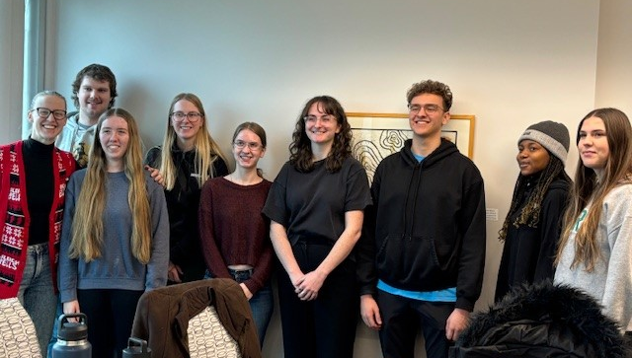
Impact on Students
Engagement & Collaboration
Student co-creation
Collaborative development
Dynamic and evolving content
Jessica Allingham and Students in Organic Chemistry 1 and 2 Lightboard Videos and H5Ps
Notes:
OER foster deeper student engagement by allowing learners to interact with course materials in dynamic and participatory ways. Unlike traditional textbooks, OER can incorporate interactive simulations, multimedia, and real-world applications, making learning more engaging and relevant.
Because OER are openly licensed, instructors can continuously refine and update content based on student feedback, ensuring materials remain current and responsive to learners’ needs.
Beyond passive consumption, OER empower students as co-creators of knowledge, encouraging collaboration in meaningful ways. When students contribute to OER—by creating case studies, editing content, or developing supplemental resources—they become active participants in their education. This process enhances critical thinking, research skills, and ownership of learning while fostering a deeper connection to the material. Co-creating OER also promotes diverse and inclusive perspectives, ensuring learning materials better reflect the experiences and needs of all students.
"Students are developing video and H5P resources for Organic Chemistry 1 and 2, high-enrollment courses with low completion rates. The project aims to create an open-access library of short videos and formative assessments to supplement in-person lectures, ultimately improving student learning and success in these challenging courses."

Slide 12
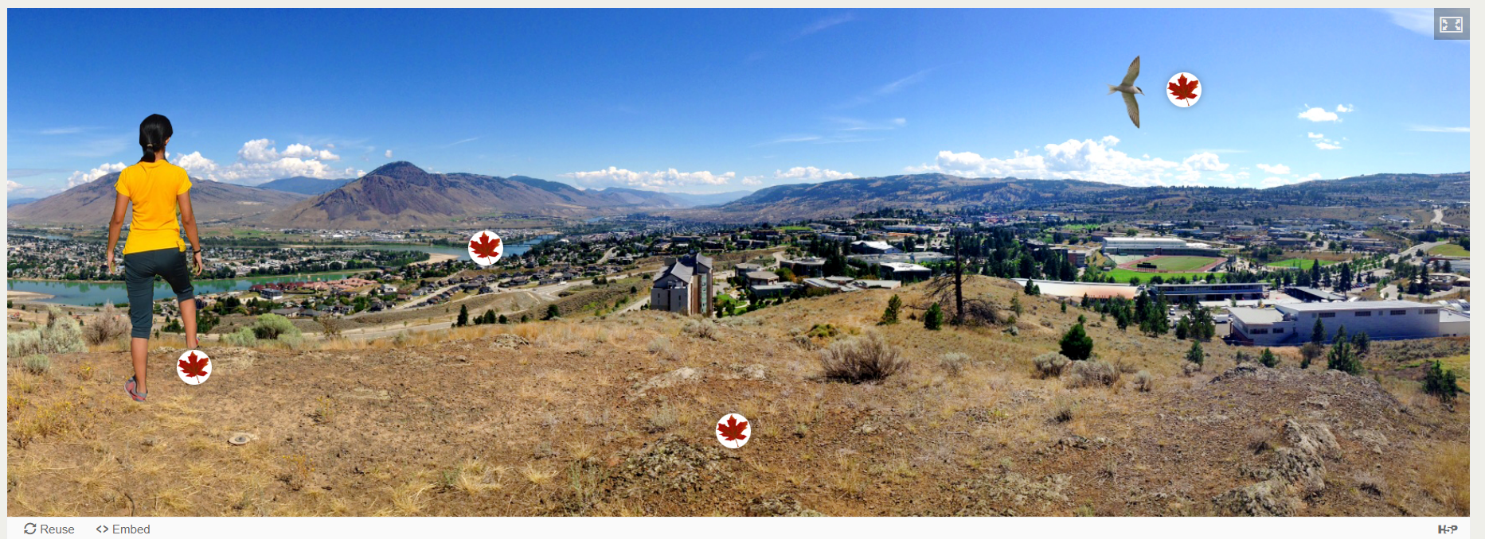
Benefits for Instructors
Empowering Instructors: Flexibility, Innovation, Collaboration
Student Success & Equity
Flexibility & Customization
Pedagogical Innovation
Scholarly Recognition
Notes:
Adopting and developing Open Educational Resources (OERs) removes financial barriers, ensuring all students have immediate, equitable access to course materials, which enhances engagement, retention, and learning outcomes in your courses. OERs offer flexibility, allowing instructors to customize content, stay current, and align with teaching goals, without relying on costly textbooks or waiting for publishers to update materials.
OERs foster pedagogical innovation by incorporating multimedia and interactive tools, making learning more dynamic. Developing OERs also enhances an instructor's teaching portfolio and scholarly impact, often contributing to tenure and promotion.
Student Success & Equity: OERs provide free access to materials, eliminating textbook costs and ensuring all students are engaged and supported.
Flexibility & Customization: Instructors can adapt content to meet course objectives and student needs, keeping materials relevant and up-to-date.
Pedagogical Innovation: OERs support the integration of new teaching strategies and interactive elements to boost student engagement.
Scholarly Recognition: Creating or adapting OERs enhances an instructor's professional growth and academic reputation. OER contributions can support tenure and promotion.
The TRUEnviroCollab is an ISP project showcasing all of the sustainability and ecosystem projects, from a variety of disciplines that are being developed by TRU and its community. There is a visual of a clickable ecosystem with areas for each group to upload content.

Slide 13
Poll: How familiar are you with Open Educational Resources (OER)?
Notes:
Presentation objectives
Importance of open educational resources (OER) and the impact of TRU Open Press
Poll Question: “Which type of OER would you find most useful in your teaching or learning?” (1-2 minutes, allowing time for responses)
Options: Digital textbooks
Interactive modules
Interactive modules
Video tutorials
Practice quizzes
Other

Slide 14
Benefits for the Institution
Investing in Access, Innovation, and Sustainability
Increased Enrollment & Retention
Enhanced Reputation
Collaboration & Community
Cost Savings
Sustainability
Notes:
OERs offer a wide range of benefits for institutions, helping them align with their broader goals of accessibility, sustainability, and innovation in education. By supporting OER adoption, institutions can foster an inclusive learning environment, improve student outcomes, and drive long-term cost savings.
Increased Enrollment & Retention: By providing free, high-quality resources, institutions can attract and retain students, particularly those facing financial challenges.
Cost Savings: OERs reduce the financial burden on students, allowing institutions to potentially attract students, improve retention rates and support a more equitable learning experience.
Enhanced Reputation: Adopting and developing OERs demonstrates the institution's commitment to innovation, accessibility, and affordability in education, positioning it as a leader in the open education movement.
Sustainability: By reducing reliance on traditional textbooks and publisher-driven costs, institutions create more sustainable educational models, reducing the environmental impact of printed materials.
Collaboration & Community Building: OERs encourage collaboration among faculty, departments, and institutions, fostering a community of practice focused on improving teaching and learning.

Slide 15
Poll: How familiar are you with Open Educational Resources (OER)?
Notes:
Presentation objectives
Importance of open educational resources (OER) and the impact of TRU Open Press
Poll Question: “What do you think is (or would be) the biggest barrier to using or creating OER in your field?" (1-2 minutes, allowing time for responses)
Options: Lack of resources
Time to create/adapt
Finding quality content
Finding quality content
Support and funding

Slide 16
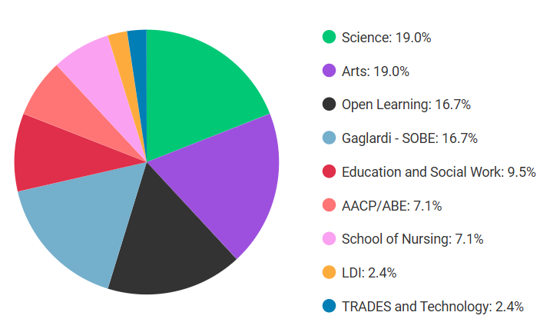
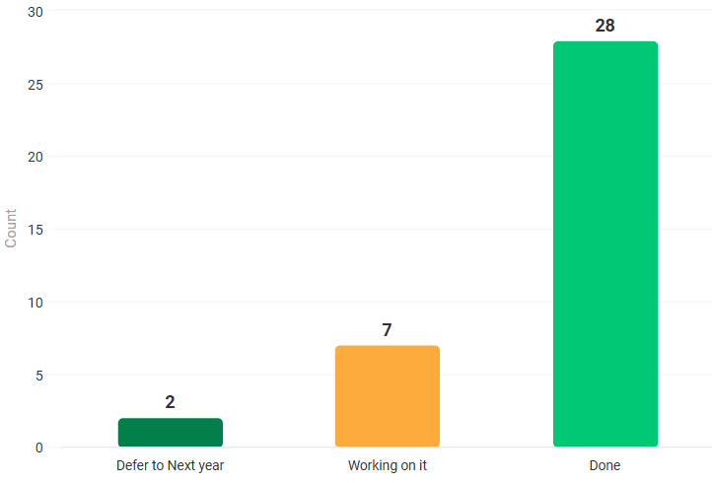
Open Press Projects
2023-2024 Projects, Year 1
Funding
Initial Consult on OER Work/ Provide Resources
Multimedia
Copyediting and Copyright Review
Site/ Domain Set up
Website Design
Training on Various Open Platforms
HTML
Notes:
Overview of TRU Open Press projects for 2023-2024
I’d like to take a moment to highlight the work of Open Press and the projects we’ve been developing.
In our first year, we took on over 30 projects, many of which were unfinished initiatives previously funded by the Open Education Working Group (OEWG) and other grants before funding cuts and the pandemic shifted institutional priorities. While assembling our amazing team took some time, we reinvested salary savings to expand our project scope.
We also established the Open Press Advisory Board, bringing together representatives from TRU Faculty, Open Learning Faculty, the TRU Library, the Research Office, LT&I, CELT, the Indigenous Office, Kamloops community members, and TRUSU. With their guidance, we developed our project proposal process, evaluation criteria, and adjudication subcommittee.

Slide 17
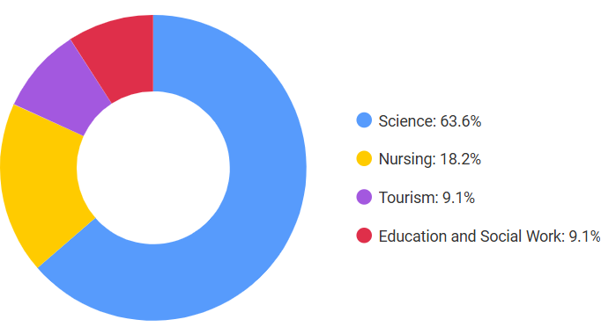
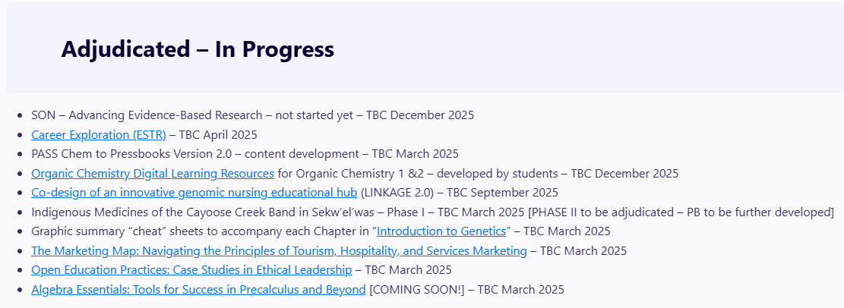
Open Press Projects
2024-2025 Projects, Year 2
Notes:
By Year 2, we had completed 11 projects and taken on 10 more. Now, 28 of those original projects are finished, covering a diverse range of disciplines, reflecting the broad impact of Open Press at TRU.

Slide 18
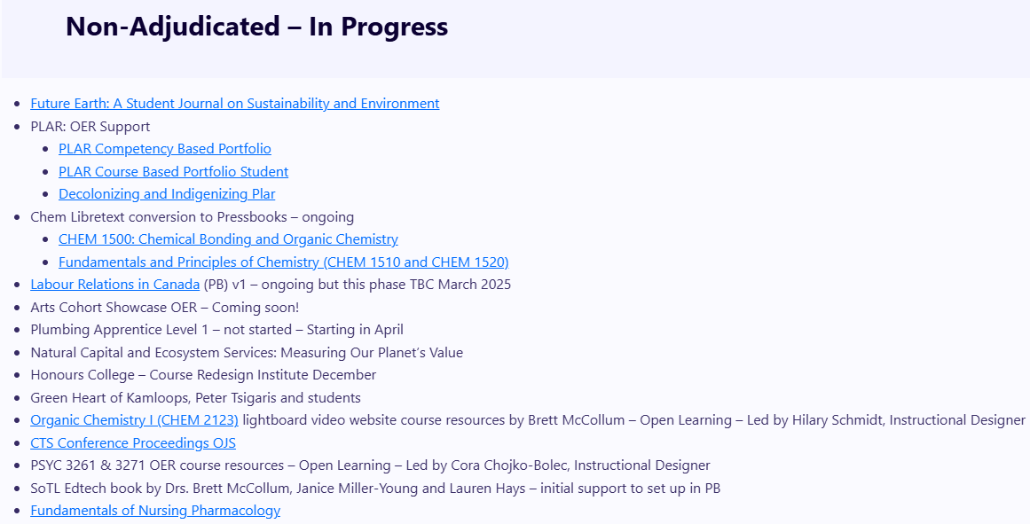
Open Press Projects
2024-2025 Projects, Year 2
Notes:
Beyond our adjudicated and Year 1 projects, we also supported other Integrated Strategic Planning (ISP) initiatives, including TRUEnviroCollab, PLAR, the Arts Cohort, Knowledge Makers, and the Honours College. Additionally, we contributed to Open Learning course OERs and smaller projects where possible.

Slide 19
Open Press Students
Co-op students: 3 co-op internships in open press editing and production.
7 co-op students from December 2024 to March 2025:
2 copyeditors/ writers/ interviews and impact stories
5 E-Learning Support Technician (ELST) positions
3 extended contracts
Research Assistants (RAs):
2023-2024 - 10 students (undergrad and grad)
2024-2025 – 9 students (undergrad and grad)
Notes:
A key part of Open Press’s success has been the contributions of students through co-op positions and research assistantships. To date, we’ve hired seven co-op students between December 2024 and March 2025. This includes two students focused on copyediting and impact stories and five students in Production (E-Learning Support Technician) roles. Three of these students have had their contracts extended based on their contributions and enthusiasm.
Beyond co-op students, we’ve also supported Research Assistants (RAs), providing hands-on experience in open education projects. In 2023-2024, we employed 10 students, both undergraduate and graduate, and in 2024-2025, we have nine RAs engaged in various research and production roles.
By integrating students into our work, Open Press not only advances open education but also provides valuable professional experience, skill development, and research opportunities for TRU students.

Slide 20
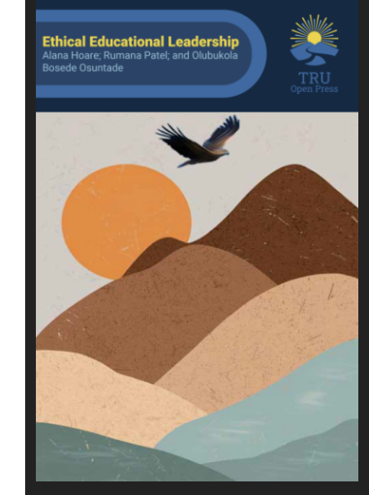
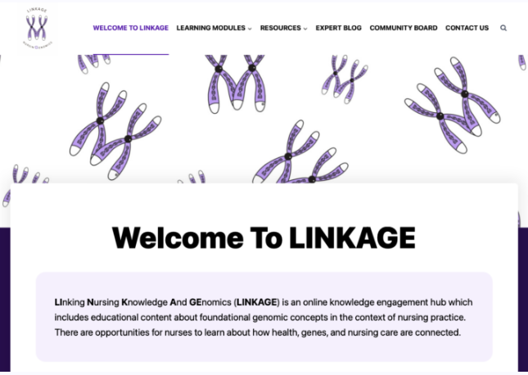
Project Showcase
“LINKAGE is about connecting nurses.” – Noopur Swadas
Notes:
The Linkage project: LInking Nursing Knowledge And GEnomics (LINKAGE) is an online multimedia knowledge engagement hub that includes educational modules about foundational genomic concepts in the context of nursing practice for nurse educators and students. It helps nurses to engage at their own pace and facilitate the integration of genomics into their practice and classrooms. Each module includes audio recording, videos and H5P. OP: site domain/ setup, design, platform support, copyediting, and copyright review
The Simulated Client Chart Database project is an open-source patient chart resembling an Electronic Medical Record (EMR) to enrich the student learning experience. The platform will be accessible to multiple disciplines, fostering collaboration and inclusivity. It will allow students to access patient charts from anywhere, promoting flexibility in learning. Additionally, it will facilitate capacity building for faculty by providing a base template for creating patient profiles, encouraging innovation and diversity in educational approaches. The project involves creating a website to host open-source patient charts, developing a template for customizable charts, and providing faculty development resources in medical informatics. The initiative aligns with TRU’s commitment to preparing students for real-world challenges and continuous improvement in education. Open Press: site domain/setup, website design, and platform support
Ethical Educational Leadership is a multimedia digital book developed on the Pressbooks platform by Alana Hoare and her amazing Research Assistants, Bukky and Rumana. It explores various ethical leadership frameworks, including Indigenous leadership approaches, and addresses current ethical challenges using a critical approach and adopting multiple ethical leadership lenses to solve real-world situations. Open Press provided site domain setup and design, training in Pressbooks, copyediting, platform support, and creating a title page for this project.

Slide 21
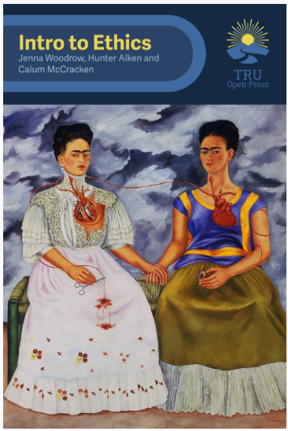
Project Showcase
Notes:
Chemistry for Biologists is a lightboard video series (which include H5P interactive assessments) by Natasha Ramroop Singh. This resource contains 20 short videos designed to explain basic but important concepts in chemistry to university students in entry-level biology. The goal of this resource is to assist learners in successfully navigating through their first year of Biology, especially in Principles of Biology I, which explores life at the meso and micro levels. It is designed to explain basic but important concepts in chemistry to university students in entry-level biology. Open Press provided Site domain/setup, website design/layout, and multimedia/ H5Ps. These videos can also be found on the Open Press YouTube channel as a playlist.
The Introduction to Ethics project, created by Jenna Woodrow and her RA students, Hunter Aiken and Calum McCracken, is a comprehensive Open Educational Resource (OER) for teaching ethics to support diverse learning needs by combining content from various sources, including "Introduction to Ethics: An Open Educational Resource", "The Originals: Classic Readings in Western Philosophy", and texts by Herodotus. It also incorporates Ethics Bowl Canada case studies for real-world scenarios. Open Press provided site/ domain setup and some design, PB training, copyediting and copyright support, and platform support, as well as the beautiful cover page, which uses newly released into the public domain painting by Frieda Khalo.
The Great Thinkers project, created by Jenna Woodrow and her RA student Gurinder Purewal, is a dynamic Open Educational Resource (OER) designed to introduce students to foundational texts in political philosophy. By curating and contextualizing works from influential thinkers, this resource encourages critical engagement with key ideas that have shaped political thought. Open Press supported the project with site and domain setup, Pressbooks training, copyediting, copyright guidance, platform support, and the visually striking cover design, which features artwork newly released into the public domain.

Slide 22
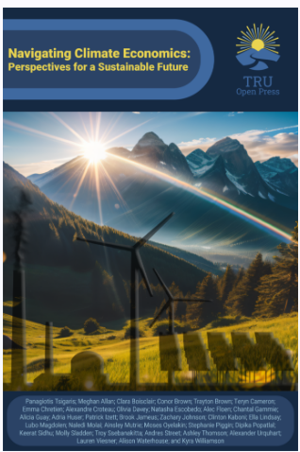
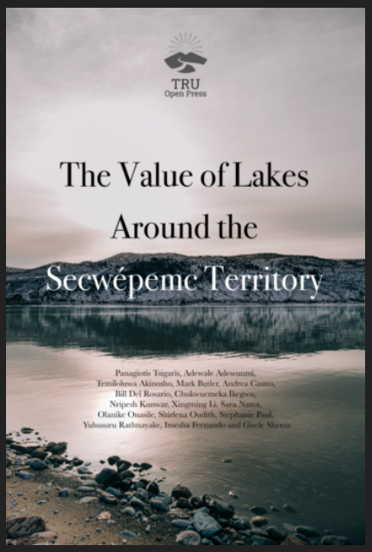
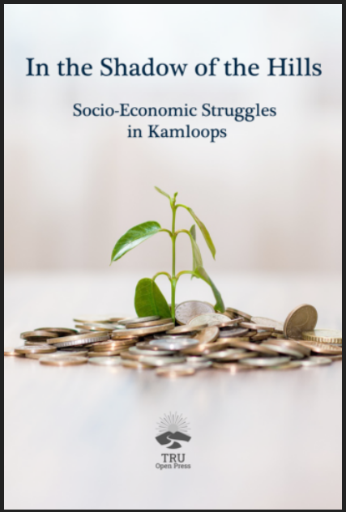
Project Showcase
Student-Driven Research
Community-Focused Impact
Notes:
Peter Tsigaris' Open Education Pedagogy Projects
Peter Tsigaris has developed several Open Education Pedagogy projects that engage students in real-world, community-focused issues. These projects provide opportunities for students to explore topics such as climate economics, environmental stewardship, Indigenous knowledge, and socio-economic challenges, all while promoting critical thinking and interdisciplinary learning.
By fostering student-driven research and integrating diverse perspectives, these projects create meaningful learning experiences that connect academic inquiry with local and global issues. Through these initiatives, Peter demonstrates the power of Open Pedagogy, encouraging students to take ownership of their learning and engage with the broader community in ways that are both impactful and relevant.
Student-Driven Research: Projects engage students in real-world issues, fostering critical thinking and interdisciplinary learning.
Community-Focused Impact: Addressing local and global challenges, including climate change, environmental conservation, and socio-economic inequality.

Slide 23
Project Showcase
https://publishing.bceln.ca/index.php/future-earth/
Notes:
Peter Tsigaris' Open Education Pedagogy Projects
Future Earth Student Journal
The Future Earth student journal offers a valuable opportunity for students to gain firsthand experience in the academic publishing process, including participation in a double-blind review and editing process. This experience not only enhances their research and writing skills but also demonstrates the importance of disseminating quality work.
Instructors, if you have students who’ve produced strong papers, encourage them to submit their work to Future Earth. You can even guide them through the review process, helping them gain additional experience in academic publishing.
For more details, visit Future Earth.

Slide 24
Poll: How familiar are you with Open Educational Resources (OER)?
Notes:
Presentation objectives
Importance of open educational resources (OER) and the impact of TRU Open Press
Poll Question: “Which type of OER would you find most useful in your teaching or learning?" (1-2 minutes, allowing time for responses)
Options: Digital textbooks
Interactive modules
Interactive modules
Video tutorials
Practice quizzes
Other

Slide 25
Call for 2025-2026 Open Press Project Proposals NOW OPEN!
Funding: Up to $7500 per project
Eligibility: Faculty, staff, students, and community members
Deadline: March 7th, 2025
OP Adjudication Subcommittee to notify project developers by mid-April
Notes:
We are excited to announce that TRU Open Press is now accepting project proposals for the 2025-2026 fiscal year. Our mission is to foster inclusive excellence, innovation, and community engagement through open access publications.
Submission Details:
Deadline: March 7, 2025
Eligibility: Faculty, staff, students, and community members with projects benefiting TRU learners
Funding: Up to $7,500 per project
Project Types:
Open Educational Resources
Open Pedagogy Projects
Open Scholarship
Innovative Knowledge Mobilization Strategies
Evaluation Priorities:
Student Benefit: Impact on student learning and involvement
Significance and Contribution: Advancement of discipline and pedagogy
Equity, Access, Indigenization, and Localization: Commitment to inclusivity and diversity
Innovation: Fostering new approaches and technologies
We encourage you to review the detailed submission guidelines and download the proposal template from our website. For any questions or to discuss your project idea, please contact us at openpress@tru.ca.

Slide 26
Types of Open Press Projects
Open
Educational
Resources (OERs)
Open Pedagogy Projects
Open Scholarship
Research
Innovative Knowledge Mobilization Strategies
Student Benefit
Significance and Contribution
Equity, Access, Indigenization, and Localization
Innovation
Notes:
Project Types:
Open Educational Resources
Open Pedagogy Projects
Open Scholarship
Innovative Knowledge Mobilization Strategies
Evaluation Priorities:
Student Benefit: Impact on student learning and involvement
Significance and Contribution: Advancement of discipline and pedagogy
Equity, Access, Indigenization, and Localization: Commitment to inclusivity and diversity
Innovation: Fostering new approaches and technologies
Innovative knowledge mobilization strategies may include:
Interactive and Multimedia Resources – Using videos, podcasts, infographics, or animations to make research more engaging and accessible.
Open Educational Resources (OERs) – Transforming research into freely available textbooks, course materials, or instructional tools.
Community-Engaged Research – Collaborating with local organizations, Indigenous communities, or industry partners to co-create and share knowledge.
Social Media & Digital Platforms – Disseminating research through blogs, open-access repositories, and social networks to reach broader audiences.
Policy Briefs & Public Outreach – Translating academic research into accessible formats for policymakers and the public.
Open Data & Interactive Dashboards – Making datasets publicly available with user-friendly visualizations to enhance transparency and engagement.

Slide 27
Openpress.trubox.ca openpress@tru.ca
Thank you!

Slide 28
References
Jhangiani, R., & Jhangiani, S. (2017). Investigating the perceptions, use, and impact of open textbooks: A survey of post-secondary students in British Columbia. International Review of Research in Open and Distributed Learning, 18(4), 172–192. https://files.eric.ed.gov/fulltext/EJ1146242.pdf
Smith, S. (2024, September 17). Book battle: Ontario university students struggling with textbook costs. Toronto Caribbean Newspaper. https://torontocaribbean.com/book-battle-ontario-university-students-struggling-with-textbook-costs/
Stein, S., Hart, S., Keaney, P., & White, R. (2017). Student views on the cost of and access to textbooks: An investigation at University of Otago (New Zealand). Open Praxis, 9(4), 403–419. https://files.eric.ed.gov/fulltext/EJ1165496.pdf
U.S. PIRG Education Fund. (2014, January 27). Survey shows students opting out of buying high-cost textbooks. PIRG. https://pirg.org/media-center/survey-shows-students-opting-out-of-buying-high-cost-textbooks/
https://leadershipethics.pressbooks.tru.ca/chapter/indigenous-leadership-ethics/
Images:
Genome Icons & Symbols

