Slide 1

TRU Open Press Advisory Board Meeting
Date: February 5, 2025 | Time: 10:00 PM – 11:00 AM

Slide 2
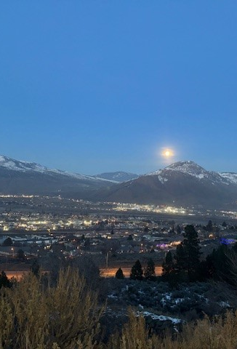
1. Welcome and Acknowledgement
RESPECT | RECIPROCITY | BALANCE
The team at the TRU Open Press is grateful to be visitors on Tk’emlups te Secwepemc territory within the unceded traditional lands of Secwepemcúl’ecw (Secwepemc Nation), where knowledge sharing has taken place since time immemorial.
EXPLORATION | DISCOVERY | STEWARDSHIP

Slide 3

Meeting Agenda
Welcome and Acknowledgement
Approval of Agenda and Previous Meeting Minutes
OP Projects – Status & Updates on Ongoing Projects
Promotion and Awareness Campaigns
Data Collection and Impact Reporting
Open Discussion & Q&A
Action Items Review and Next Steps
Adjournment & Closing Remarks
Notes:
2. Approval of Agenda and Previous Meeting Minutes
Approval of October 8, 2024, meeting minutes.

Slide 4

2. Approval
Agenda for February 5 Agenda
October 8 meeting minutes
Notes:
Recognize New member: Natasha Ramroop Singh
Bensly graduating soon? Thanks for being our TRUSU representative!

Slide 5
3. OP Projects – Status
Notes:
2023-2025 Project Updates (Dani Collins)
Completed projects, carryovers, and new submissions
Note from university to Career project funding was in the Spring of 2024, but the subsequent writing was not ready for set up, copy editing, etc. until January 2025.

Slide 6
3. OP Projects – Status
Plumbing Apprenticeship Level 2 books set to launch in March 2025, pending sign off from Skilled Trades BC – to be used all over BC!
Some projects still in content development
Some project development occurring while beta-testing with students
ISP - TruEnviroCollab to be launched end of February 2025
Notes:
2023-2025 Project Updates (Dani Collins)
Completed projects, carryovers, and new submissions

Slide 7
3. OP Projects – Status
Notes:
2023-2025 Project Updates (Dani Collins)
Completed projects, carryovers, and new submissions

Slide 8
3. OP Projects – Status
Plumbing Apprenticeship Level 1 books set to launch in March 2026, pending sign off from Skilled Trades BC – to be used all over BC!
ISP project support
Open Learning project support
Some project developers advised to apply for project funding for RAs, etc.
Notes:
2023-2025 Project Updates (Dani Collins)
Completed projects, carryovers, and new submissions

Slide 9
3. OP Projects – Students
Co-op students: To date, we've hired 7 co-op students from December 2024 to March 2025
  2 students for copyediting/ impact stories
  5 students in the Production (E-Learning Support Technicians (ELST) positions
  3 students had extended contracts
  Research Assistants (RAs):
  2023-2024 - 10 students (undergrad and grad)
  2024-2025 – 9 students (undergrad and grad)
Notes:
2023-2025 Project Updates (Dani Collins)
Completed projects, carryovers, and new submissions

Slide 10
Project Subcommittee Updates
Adjudication Committee
All members willing to be on the subcommittee again for the 2025-2026 fiscal year projects?
Bensly available as TRUSU respresentative on Project Adjudication Subcommittee after March 7th?
Adjudication Process
Developer feedback
New submission form
Project Proposal submission deadline is March 7, 2025
Adjudication before April 2025
Funds awarded by April to successful project developers
Notes:
Last timetable did not allow enough time for project developers to spend the funding on RA, etc. and be done by end of fiscal year – not fair
New date allows for funding availability for full year

Slide 11

4. Promotion & Awareness Campaigns
2024 December Newsletter
Project Launches
TRU Connect
Student Street OER and OP project showcase, January 8, 2025
Teaching Practices Colloquium (TPC), February 18, 2025
Open Ed Talks 2025, March 2025
  Open Ed Talks 2025 Kickoff Event, March 5 – 11:00am to 1:30pm sponsored by Bccampus, featuring talk by Dave Cormier, “What might Open Ed look like?” (actual title TBD)
  Open Ed Talk Streaming Lunch’n’Learn and ½ hour facilitated discussions, March 12, 19, and 26, 11-1:00pm

Slide 12
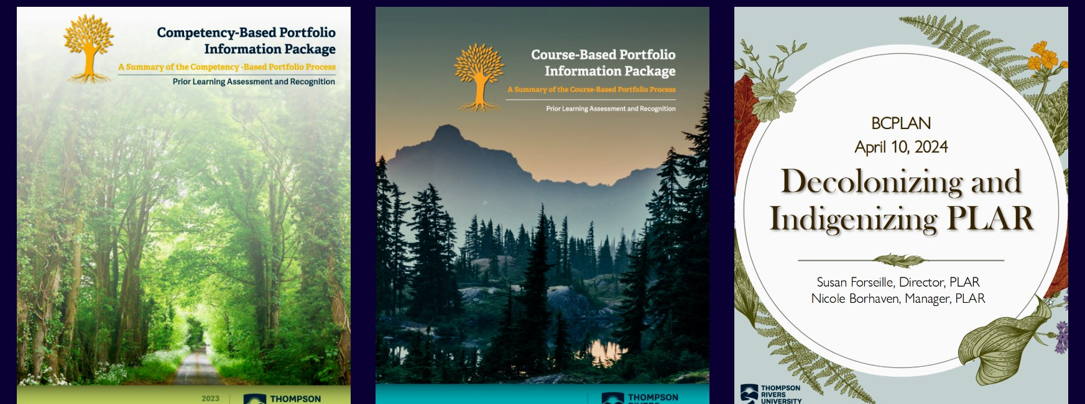
Discussion: Explore ideas for further engaging students, faculty and community in TRU Open Press initiatives.
Notes:
Research Hub event with students this Spring 2025? (idea carried forward from October 8 meeting)

Slide 13

5. Data Collection and Impact Reporting
Impact Stories
Impact Summaries (qualitative)/ Project Descriptions (quantitative)
  Used in course, when, estimated # of students, average price of textbook or resource replaced, estimated savings
Surveys for Students and Instructors/ Project Developers
Metrics attached to every project
  Alana's Ethical Education project has 1295 total unique visitors to date!
  Peter's navigating Climate book has 5.2K visitors!
Notes:
OER Impact Data (Dani Collins)
Adoption metrics, survey insights, usage statistics.

Slide 14

8. Open Discussion & Q&A
Notes:
Open floor for board members.
Potential new collaborations or project ideas.
Suggested Image: Team discussion or brainstorming session.

Slide 15

9. Action Items Review and Next Steps
  Note: action items from October meeting still in progress
    Revised project submission form in progress
    In person student event @ Research Hub? (Sukh)
    Archive OER (Brenda & Dani)
    Planning for post 2026 sustainability (Brian and Marie)
    Next OP Advisory Board meeting – May/June 2025
Notes:
Recap of key action items.
Assign responsibilities and set next meeting date.
Suggested Image: Checklist or task management visual, calendar with next meeting date.
Submission to other collections?

Slide 16

10. Adjournment & Closing Remarks
Notes:
Thank attendees for their contributions.
Thank you for your dedication and commitment to advancing the mission of TRU Open Press!
Suggested Image: "Thank you" slide with TRU branding or a teamwork visual.

