Slide 1
Land Acknowledgment
EXPLORATION | DISCOVERY | STEWARDSHIP
Thompson Rivers University is located on the traditional and unceded territory of the Secwépemc Nation, specifically the Tk'emlúps te Secwépemc people. We honor and respect their deep connection to these lands, waters, and resources, and we recognize the significance of understanding, valuing, and learning from Indigenous histories, cultures, and knowledge systems in all aspects of our work.
As we launch Future Earth: A Student Journal on Sustainability and Environment, we reaffirm our commitment to fostering an inclusive academic community that embraces diverse perspectives and champions sustainability for the benefit of all communities. Our mission is deeply inspired by the Indigenous principles relating to Respect, Reciprocity, Balance, Exploration, Discovery, and Stewardship, which guide us in our efforts to create meaningful, impactful, and ethical student research.
By aligning with these principles, Future Earth seeks to cultivate a space for collaborative learning and inquiry, honouring the interdependence of all living beings and the responsibility we share in caring for our environment. Through this work, we aim to support students in engaging with sustainability research that respects Indigenous knowledge and promotes a harmonious balance between human and ecological systems.
RESPECT | RECIPROCITY | BALANCE
This Photo by Unknown Author is licensed under CC BY-SA-NC
Notes:
As we gather for the launch of the Future Earth Student Journal, I want to acknowledge that Thompson Rivers University is located on the traditional and unceded lands of the Secwépemc Nation, specifically the Tk'emlúps te Secwépemc people. This land has been a place of gathering, learning, and stewardship for generations, and it continues to hold profound cultural and spiritual significance.
In launching this journal, dedicated to sustainability and environmental solutions, we are inspired by Indigenous values of respect, reciprocity, and balance with the natural world. May this journal honor these values by fostering a space for diverse voices and ideas, contributing to a more inclusive and compassionate understanding of our shared responsibilities to the Earth.

Slide 2
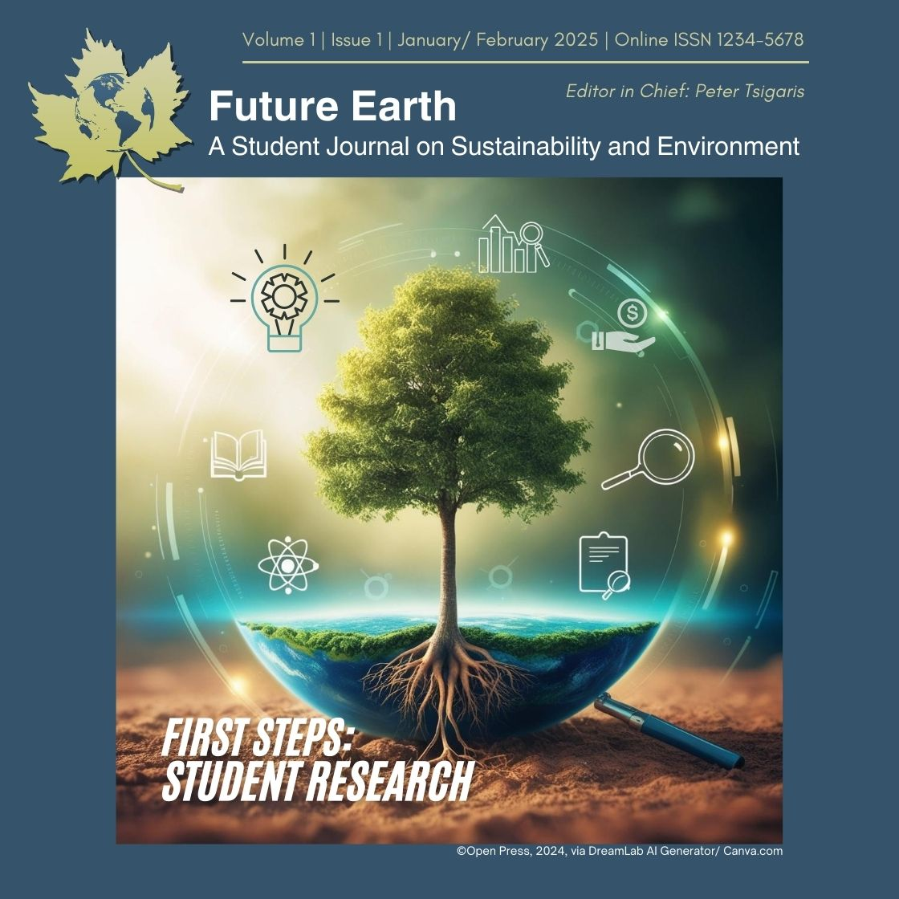
Welcome to Future Earth!
Purpose
Announce the launch and describe the journal's vision to advance sustainability discourse.
Focus
Sustainability and environmental research from a multidisciplinary student-led perspective
Platform
Hosted at Thompson Rivers University, featuring a diverse editorial board led by Dr. Peter Tsigaris.

Slide 3
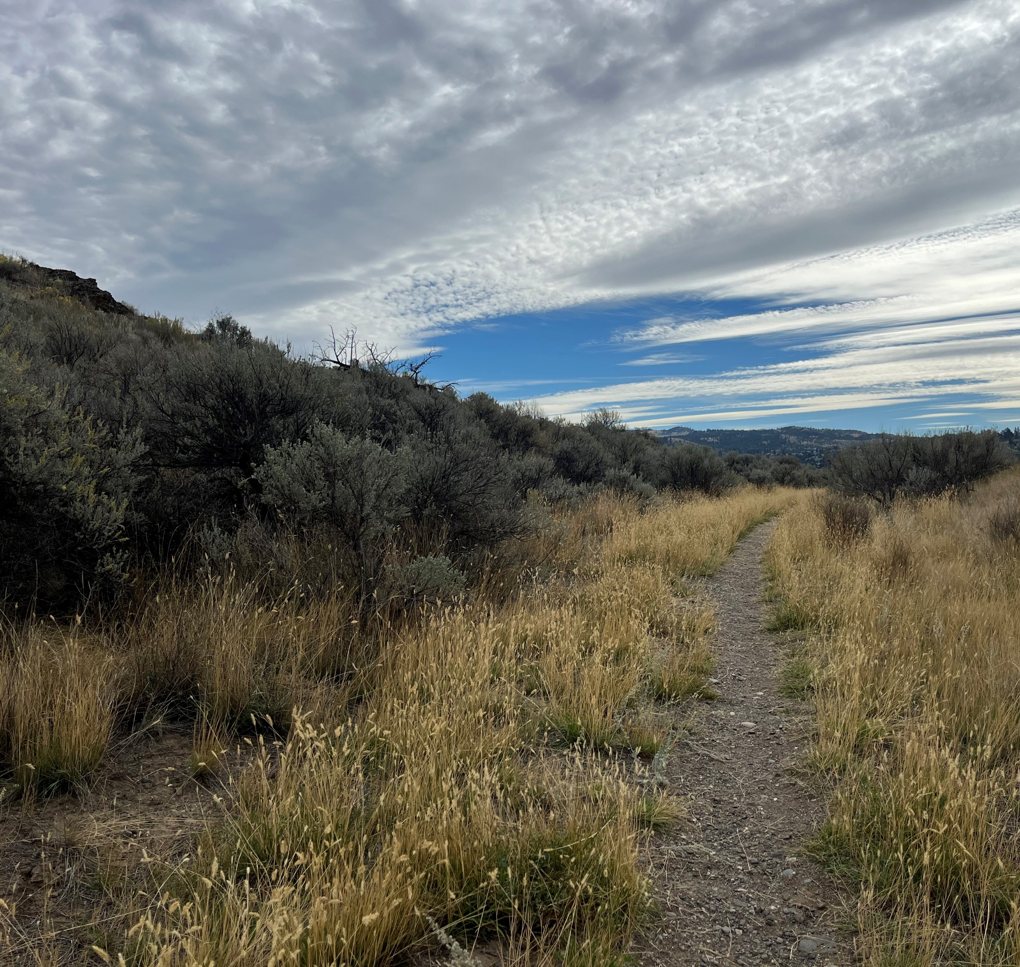
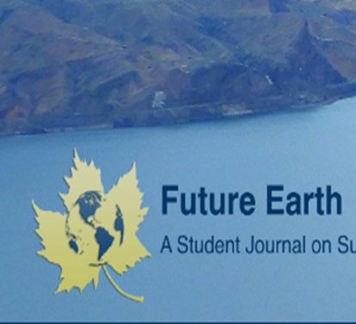
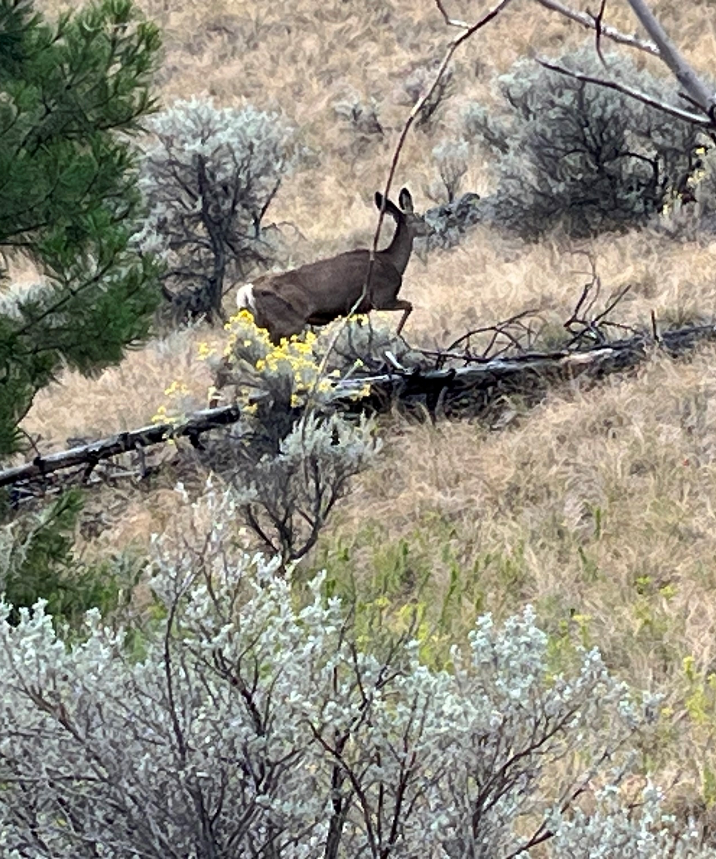
About Future Earth
Mission and Scope
Future Earth is a vibrant, student-driven journal spotlighting innovative research on sustainability and environmental solutions. Designed for undergraduate and graduate contributors, it amplifies diverse perspectives to inspire dialogue and action on pressing global issues.
Access: Open and free of charge
Review: Blinded by two faculty experts
Frequency of issues: Bi-annual; Fall and Spring
Notes:
About the *Future Earth* Student Journal (5 mins)**
Let’s start by diving into the mission and vision behind Future Earth. Future Earth is an engaging new journal created to spotlight innovative research on sustainability and environmental solutions, with a strong focus on student authorship It’s specifically designed to support undergraduate and graduate contributors, offering a platform for diverse voices and inspiring meaningful discussions on global issues.
Our goals for Future Earth include:
Championing student research that addresses pressing environmental challenges.
Embracing a multidisciplinary approach to foster well-rounded, holistic solutions.
Creating a launchpad for emerging scholars.
And building a network of students, faculty, and professionals who are passionate about making an impact on our planet.
Future Earth is all about empowering students to contribute to the sustainability dialogue and drive action on critical environmental issues.

Slide 4
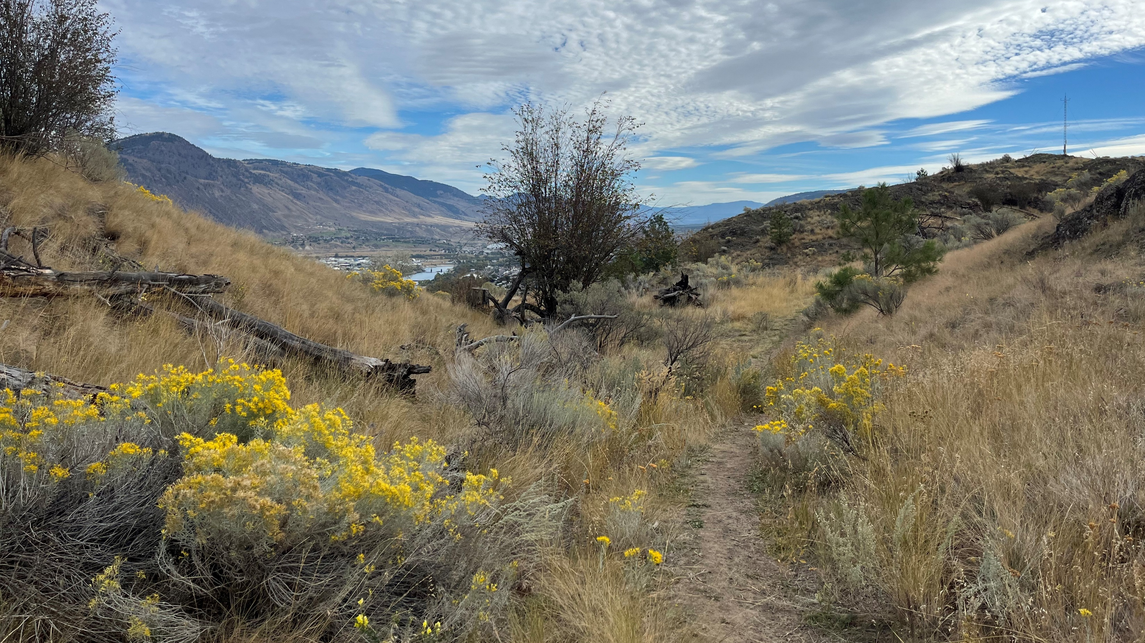
About Future Earth!
Areas of interest: biodiversity, business research, community-based practices, conservation, ecosystem services, Indigenous research, environmental policy, resource management, social and climate justice, tourism studies, and many other related areas.

Slide 5
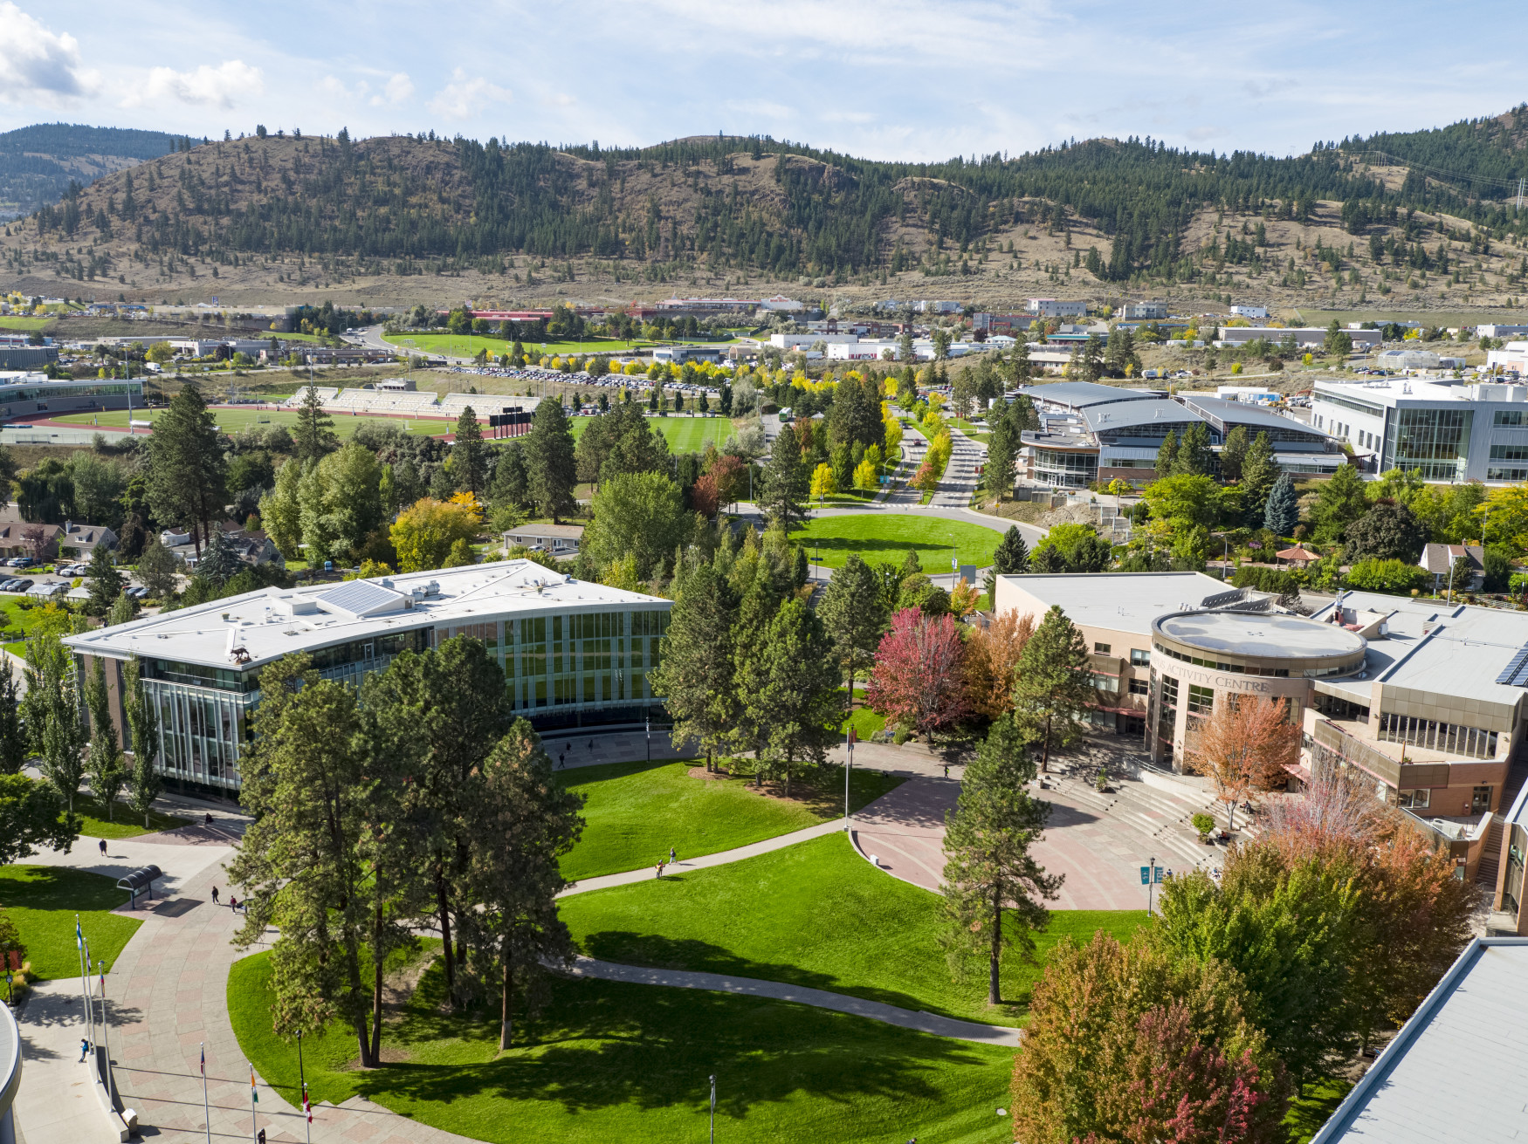
About Future Earth!
Content Types
Accepts research articles, perspectives, commentaries and opinions, creative non-fiction & literary works, case studies, Indigenous perspectives, and more.
Quality
Submissions must be well-researched, scientifically rigorous, and innovative. Faculty reviewed.
Key Dates
Deadline for the inaugural issue: End of January. Faculty and conference submissions are encouraged.
This Photo by Unknown Author is licensed under CC BY-SA-NC

Slide 6
Benefits to Reviewers
Career Advancement: Reviewing manuscripts can be a significant component in tenure and promotion decisions, demonstrating active engagement in your field.
Annual Performance Reviews: Contributions to peer review can be highlighted in Academic Performance Annual Reviews (APAR), showcasing commitment to the academic community.
Mentorship Opportunities: Help students and emerging scholars improve their work. Your constructive feedback can guide them to publish high-quality research.
Acknowledgment: Receive gratitude in publications for your role in guiding research, which enhances your academic portfolio and visibility.

Slide 7
Benefits to Reviewers
Guest Editor Opportunities: Engage more deeply by serving as a guest editor, focusing on special topics or standalone issues, which further establishes your expertise and leadership in the field.
Annual Acknowledgment: The journal will acknowledge the voluntary contributions of its faculty at the end of the academic year, celebrating their dedication and impact on the academic and local community.

Slide 8
Thank you!
https://publishing.bceln.ca/index.php/future-earth/
Special thanks to Dani Collins, Jessica Obando Almache, Kaitlyn Meyers, Christina Bergeron, Sukh Matonovich, Erin May (TRU Library)
and all of you Faculty Editors!
Notes:
Special Thank you to Christina Bergeron for setting this launch presentation up tonight and making sure we’re all fed, Thank you to Sukh Matanovich

