Slide 1
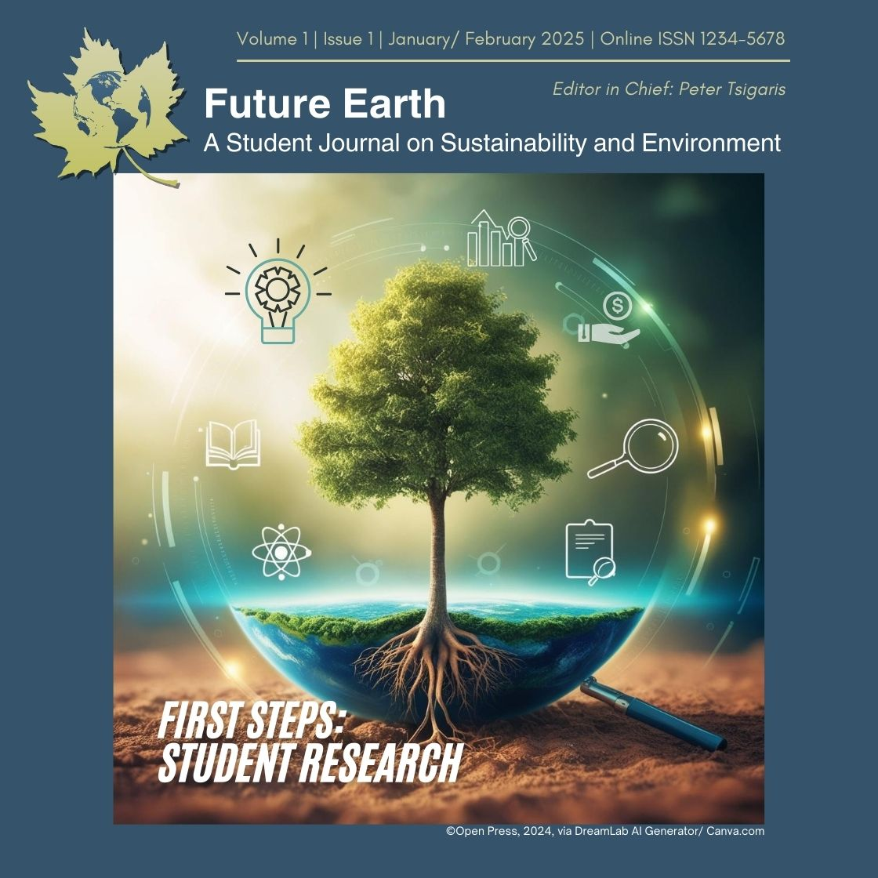
Welcome to Future Earth!
Introducing the Student Journal & OJS Workflow
Notes:
Welcome, everyone!
[Introductions]

Slide 2
Land Acknowledgment
EXPLORATION | DISCOVERY | STEWARDSHIP
Thompson Rivers University is located on the traditional and unceded territory of the Secwépemc Nation, specifically the Tk'emlúps te Secwépemc people. We honor and respect their deep connection to these lands, waters, and resources, and we recognize the significance of understanding, valuing, and learning from Indigenous histories, cultures, and knowledge systems in all aspects of our work.
As we launch Future Earth: A Student Journal on Sustainability and Environment, we reaffirm our commitment to fostering an inclusive academic community that embraces diverse perspectives and champions sustainability for the benefit of all communities. Our mission is deeply inspired by the Indigenous principles relating to Respect, Reciprocity, Balance, Exploration, Discovery, and Stewardship, which guide us in our efforts to create meaningful, impactful, and ethical student research.
By aligning with these principles, Future Earth seeks to cultivate a space for collaborative learning and inquiry, honouring the interdependence of all living beings and the responsibility we share in caring for our environment. Through this work, we aim to support students in engaging with sustainability research that respects Indigenous knowledge and promotes a harmonious balance between human and ecological systems.
RESPECT | RECIPROCITY | BALANCE
This Photo by Unknown Author is licensed under CC BY-SA-NC

Slide 3
Agenda
Welcome & Session Objectives
Overview of the Future Earth Student Journal
Introduction to Open Journal Systems (OJS) Platform
Future Earth Journal Workflow on OJS
Roles of Faculty Editors
Q&A and Feedback
Conclusion & Next Steps
Notes:
Introduction to the Presentation (5 mins)**
I’m excited to be here today to introduce Future Earth, a new student journal dedicated to publishing research on global sustainability and environmental issues.
In today’s session, we’ll walk through the purpose of Future Earth, its mission, and the workflow we’ll be using on the Open Journal Systems, or OJS, platform. Our objectives are to:
Introduce Future Earth and its focus on student-led research.
Provide an overview of the OJS platform, which will manage our submission, review, and publication processes.
Walk through the specific workflow for Future Earth on OJS, covering manuscript submission, faculty review, editing, and publication.
Clarify the role of faculty editors in maintaining quality and ethical standards.
Conclude with a Q&A to address any questions you may have.
Finally, I’ll be sharing resources and next steps for further training on OJS and Future Earth workflows. Let’s dive in!

Slide 4
About Future Earth
Mission and Scope
Future Earth is a vibrant, student-driven journal spotlighting innovative research on sustainability and environmental solutions. Designed for undergraduate and graduate contributors, it amplifies diverse perspectives to inspire dialogue and action on pressing global issues.
Frequency of issues: Bi-annual; January/February and July/August
Goals
Championing groundbreaking student research on sustainability and environmental challenges
Embracing a multidisciplinary approach to foster holistic solutions
Providing a launchpad for emerging scholars
Connecting a network of students, faculty, and professionals passionate about environmental impact
Notes:
About the *Future Earth* Student Journal (5 mins)**
Let’s start by diving into the mission and vision behind Future Earth. Future Earth is an engaging new journal created to spotlight innovative research on sustainability and environmental solutions, with a strong focus on student authorship It’s specifically designed to support undergraduate and graduate contributors, offering a platform for diverse voices and inspiring meaningful discussions on global issues.
Our goals for Future Earth include:
Championing student research that addresses pressing environmental challenges.
Embracing a multidisciplinary approach to foster well-rounded, holistic solutions.
Creating a launchpad for emerging scholars.
And building a network of students, faculty, and professionals who are passionate about making an impact on our planet.
Future Earth is all about empowering students to contribute to the sustainability dialogue and drive action on critical environmental issues.

Slide 5
Overview of the Open Journal Systems (OJS) Platform
What is OJS?
Open-source software widely used for managing and publishing academic journals.
Created by the Public Knowledge Project; many journals hosted by SFU (FE is hosted by BC ELN via TRU Library).
Supports editors with a streamlined workflow for submissions, reviews, editing, and publication.
Key Features for Faculty Editors
Submission Management: Centralized system to handle incoming manuscripts.
Faculty Review Workflows: Facilitates organized review processes.
Editorial Tools: Efficient communication with authors and faculty reviewers.
Publishing Metrics: Tools to track journal impact and reach.
Notes:
Overview of the Open Journal Systems (OJS) Platform (7 mins)**
Now, let’s talk about the Open Journal Systems, or OJS, platform.
So, what is OJS? OJS is a widely used open-source software designed to help manage and publish academic journals. It’s particularly valuable because it simplifies each stage of the publishing process—from initial submission to final publication.
For editors, this means a much more streamlined experience. Rather than juggling multiple tools, OJS provides everything you need in one place.
For faculty editors specifically, OJS offers several key features:
Submission Management: All incoming manuscripts are stored in one central location, making it easy to organize.
Faculty Review Workflows: This feature enables editors to efficiently assign, track, and communicate with reviewers.
Editorial Tools: Editors can use built-in tools to communicate with authors and reviewers, keeping everyone aligned and on schedule.
Publishing Metrics: OJS tracks important metrics like views and downloads, giving editors insights into the journal's reach and impact.
Overall, OJS is designed to make journal management smoother and more efficient, allowing faculty editors to focus more on content quality and less on administrative tasks."

Slide 6
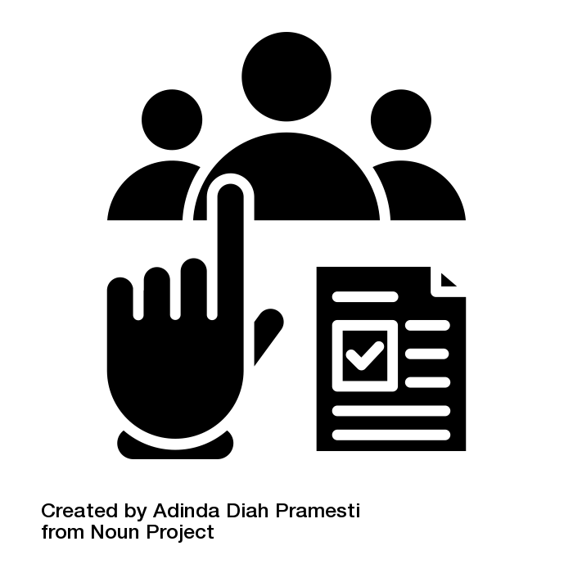
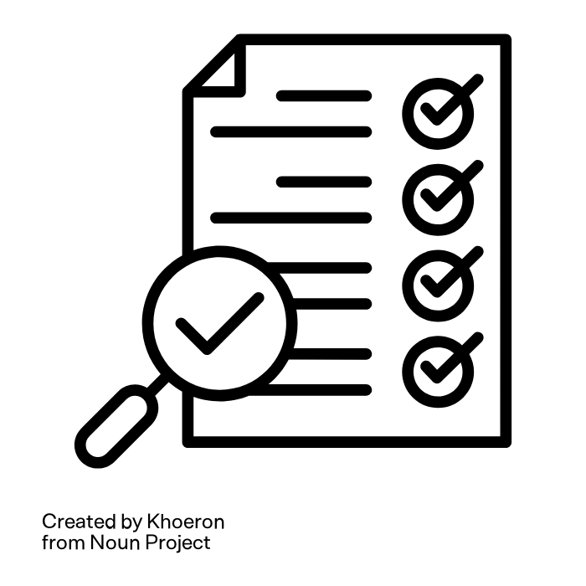
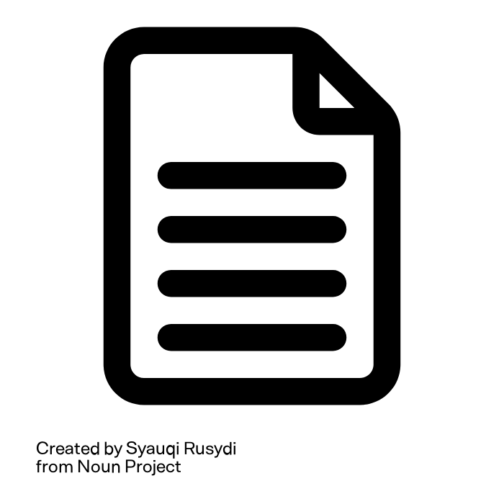
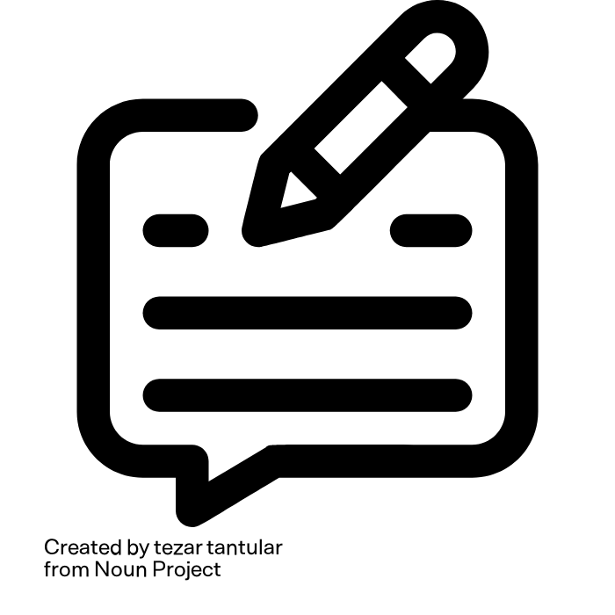
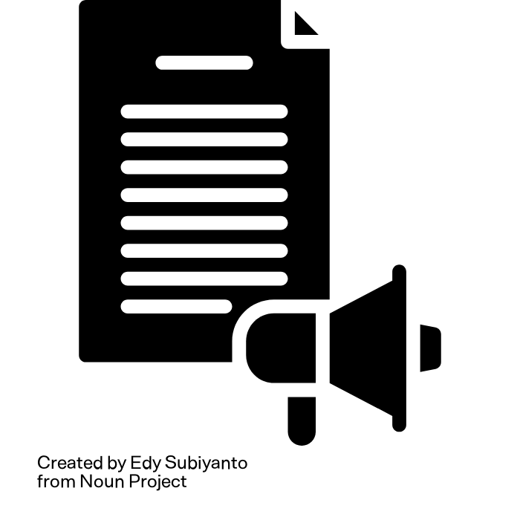
Future Earth Journal Workflow on OJS
Submission
Initial Evaluation & Review
Review Report
Feedback & Author Revision
Production & Publication
Copyediting
Assign Faculty Reviewer
Assign
Section Editor
Notes:
Future Earth* Journal Workflow on OJS (10 mins)**
Let’s walk through the workflow for submissions to the Future Earth journal on the OJS platform, covering each stage of the faculty review and publication process.
Submission: Student authors, often working with faculty guidance, submit their manuscript through the journal’s OJS platform, following our author guidelines. If the paper originates from a course, it should include a review report from their instructor. To maintain impartiality, we anonymize the author’s information for the review stage.Initial Evaluation and Review: The Chief Editor assigns the submission to a relevant faculty editor. The faculty editor checks for guideline adherence, evaluates the instructor’s report (if available), and uses similarity software to verify academic integrity. Based on these evaluations, the paper is sent to two associate editors in the field, or just one if an instructor review was already completed.Review Report: Our associate editors assess the manuscript for originality, clarity, rigor, and relevance. They provide constructive feedback through OJS, including suggestions for improvement and recommendations for acceptance or revision. If accepted, the manuscript moves forward for copy-editing.Author Revision: If revisions are needed, the author receives detailed feedback from reviewers and has a set period to make improvements before resubmitting.Production and Publication: Finally, the manuscript undergoes copy-editing, and a Production Editor creates the PDF and HTML galley proofs. The author reviews these proofs before we schedule the article for publication.This structured process upholds quality and integrity, while providing authors with constructive, valuable feedback to strengthen their work.
- How faculty editors can assign reviewers, track review progress, and make editorial decisions.

Slide 7
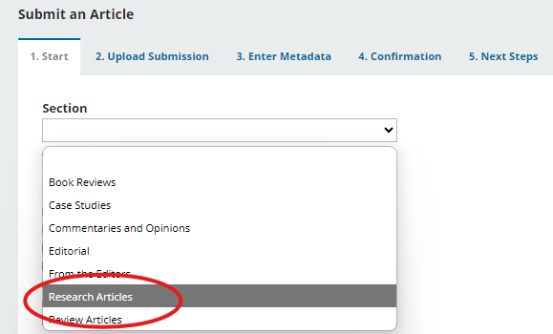
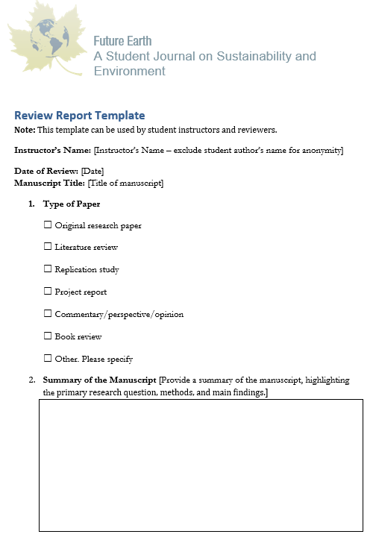
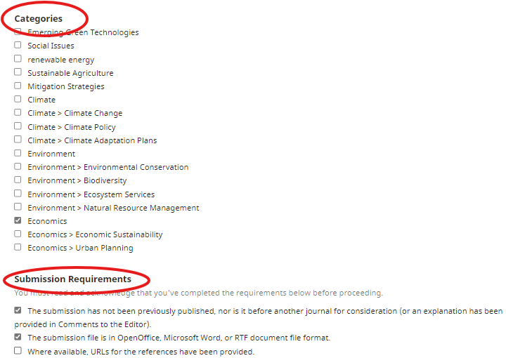
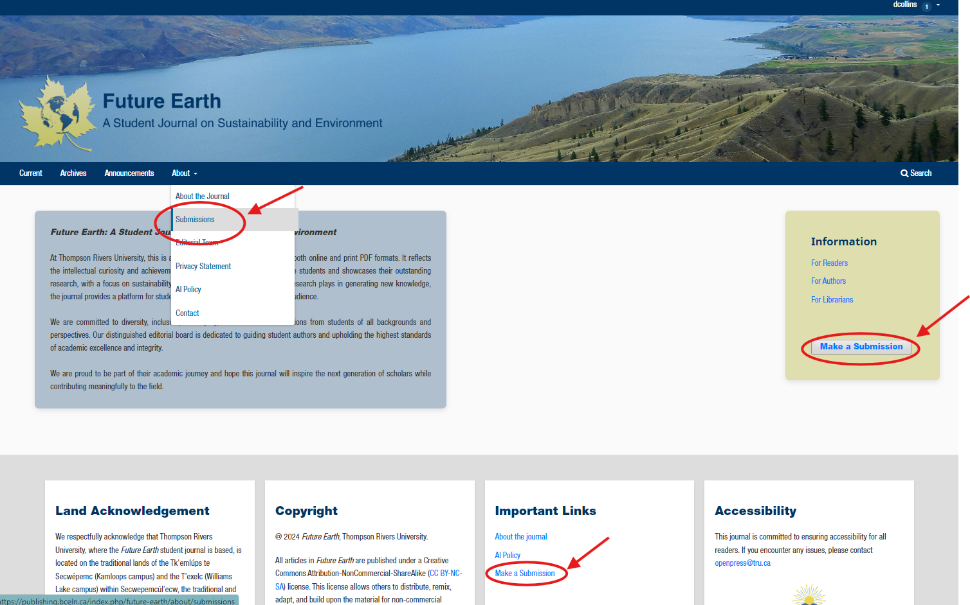
Submission Process
Start
Upload Submission
Enter Metadata
Confirmation
Next Steps
Student submits the manuscript via OJS, following author guidelines.
If the manuscript is from a course, it may include an instructor’s review report.
Manuscript is anonymized to ensure impartiality.
Chief Editor assigns the article to a Faculty Editor (Section Editor) for initial review.
Notes:
**Submission Process**
Student authors, under faculty guidance, submit their manuscripts through the journal’s OJS platform, following author guidelines. Course-related submissions should include a review report from the instructor. To ensure impartiality, author details are anonymized during review. Students select the submission type (e.g., review or research article) and category (e.g., economics or climate), then confirm each submission requirement checkbox. They can add notes to the Editor, such as “Review report included,” and must check the copyright acknowledgment.
Students proceed through the steps: Start, Upload Files (including Review Report), Enter Metadata, and Confirm (Finish Submission). Co-authors may be added. Faculty editors can submit commentaries, opinions, or editorials and may skip double-blind review.
Once submitted, the Chief Editor assigns the paper to a Section Editor for an initial review, ensuring guideline compliance before passing it to reviewers.

Slide 8
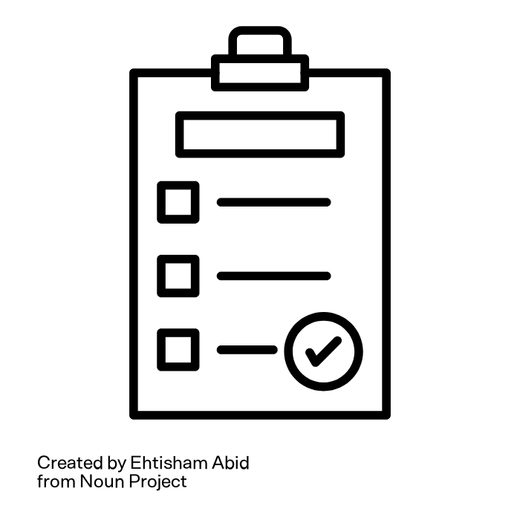
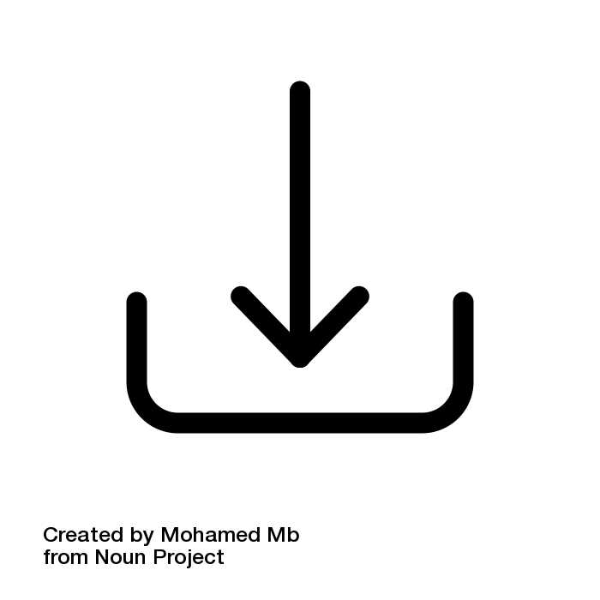
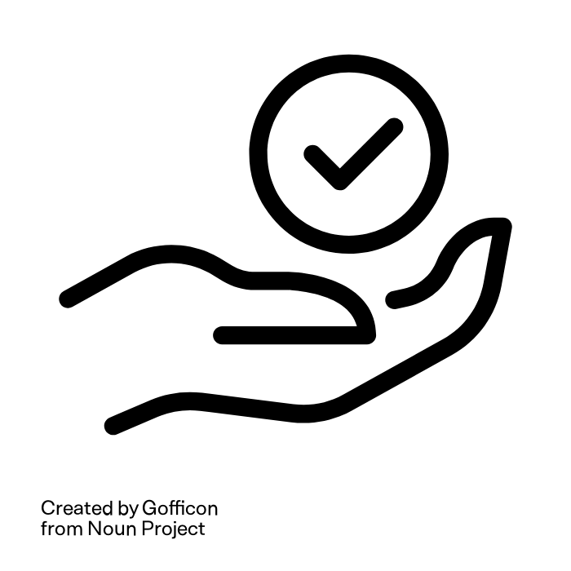
Review Process – Editorial Workflow
Request Section Editors assign reviewers based on expertise.
Guidelines Reviewers receive clear instructions and criteria. *Review Report* can be used as well.
Download and Review Reviewers access manuscript, assess quality, and provide feedback.
Completion Reviewers submit their evaluations and manuscript revisions to send Section editor (OJS discussion or in uploaded Review Report)
Notes:
- **Faculty Review Process**
Overview of the Faculty review system in OJS (single-blind, double-blind, or open review).
The review process begins when the Section Editor receives an email notification from the Chief Editor, Peter, through the OJS system. Section Editors can then click the link to view the submission and assign reviewers based on their expertise.
Reviewers are provided with specific guidelines outlining review criteria. They download and evaluate the manuscript, focusing on key areas like clarity, methodology, literature review, data analysis, and relevance to sustainability issues. For instance, they might suggest reorganizing sections to improve flow, recommend additional data to strengthen methodology, or propose further connections to environmental applications.
Reviewers may document their feedback in a Review Report or directly in a discussion with the author and Section Editor. Finally, once they submit their feedback, Section Editors decide on next steps, such as whether the article needs revision or is ready for acceptance.
These targeted recommendations from the reviewers are critical in enhancing the quality and impact of Future Earth manuscripts, ensuring they meet both academic and real-world relevance standards.

Slide 9
Editing and Revision Process (Open Press)
Reviewer to Move Article to Copyediting Stage
Copyedit Draft File
Send New Copyedited file to Production Stage
Consult with Author (Discussion window)
Section Editor accepts or denies manuscript and moves it to Copyediting stage in OJS
Copyediting Assignment – Copyeditor assigned after manuscript acceptance.
Review of Content – Ensures clarity, consistency, accessibility, and readability.
Language & Grammar – Corrects language errors, improves flow.
Formatting – Ensures consistency in style and layout (uses Word template with logo etc.).
Final Checks – Verifies citations, references, and adherence to journal guidelines.
Copyedited file is sent to Production Stage – Section Editor is notified (Production Editor automatically notified when moved to next stage).
Notes:
- **Editing and Revision Process**
Now, let’s talk about the Editing and Revision Process and how it supports our commitment to high publication standards.
After an author has addressed initial revisions with the faculty editor, Open Press steps in to complete the final stages of copy editing and revision and then the Production of PDF and HTML galleys.
As discussed, Faculty editors/ reviewers play a crucial early role in facilitating feedback between authors and reviewers, helping authors understand and apply essential revisions to strengthen their manuscripts. Once these initial steps are complete, Open Press takes over to handle the final copy editing and production of galleys. This stage involves a thorough review with the author to refine language, correct any remaining errors, and ensure the manuscript meets our quality and consistency standards.
This dual-level review process, where faculty editors provide initial guidance and Open Press handles final revisions, allows us to publish work that is both polished and impactful. By maintaining clear, structured communication and emphasizing quality at every stage, we ensure each publication upholds the professional standards of Open Press.

Slide 10
Production & Publication Workflow (Open Press)
Production Editor Prepares Galleys
Consult Copyeditor & Author (Discussion)
Metadata Updated
Galleys uploaded to Publication Tab
“Scheduled for Publication”
Production/Layout Editor
Ensures Accessibility Standards (tables, images, alt text, long descriptions, etc.)
Creates PDF and HTML galleys (proofs) for final review
Updates metadata in Publication tab and uploads final article galleys
Final Publication
Production Editor notifies author to review proofs before publication and ensures that Author Bio information is included in contributor metadata.
Production Editor notifies Chief Editor that article is ready to be “Scheduled for Publication”
Chief Editor schedules the article for release in Journal issue.
Notes:
- **Publication Workflow**
In the Production & Publication Workflow, the Production/Layout Editor, often Jessica or a co-op student, plays a key role. They ensure accessibility standards, including alt text and descriptions, then create PDF and HTML proofs. Metadata is updated, and final galleys are uploaded.
In the Final Steps—formatting, proofing, and approval—timeliness and transparency are essential. The Production Editor notifies the author for a final proof review, ensures the author’s bio is included, and alerts the Chief Editor to schedule publication, ensuring a smooth, efficient process.

Slide 11
Key Responsibilities of Faculty Editors & Reviewers
Shaping the Journal’s Content
Guide the journal’s content direction, ensuring alignment with the journal mission.
Review submissions, provide constructive feedback, and make editorial decisions.
Managing Reviewer Selection
Select appropriate reviewers for each manuscript.
Balance fairness, expertise, and timeliness in the review process.
Quality Assurance
Importance of maintaining academic rigor and journal quality.
Handling potential conflicts of interest, ensuring ethical review, and compliance with editorial policies.
Image by Arturo Añez from Pixabay
Notes:
Key Responsibilities of Faculty Editors (5 mins)**
Faculty editors and reviewers play a crucial role in shaping Future Earth Journal’s content and upholding its mission to publish impactful research on sustainability. Their responsibilities include guiding the journal's direction by selecting high-quality submissions, offering constructive feedback, and making informed editorial decisions.
They also manage the reviewer selection process, ensuring that each manuscript is reviewed by experts who bring fairness and timely insights to the process.
Lastly, faculty editors uphold the journal's quality and integrity by maintaining academic rigor, addressing conflicts of interest, and ensuring compliance with ethical standards and editorial policies. This commitment safeguards the journal’s credibility and the trust of our readers and authors.

Slide 12
Key Roles and Responsibilities
Chief Editor (Peter Tsigaris)
Receives submissions and assigns articles to Section Editors (Add Participants)
Schedules articles for Publication; Oversees journal issues and process
Announcements/Editorials
Faculty Reviewers
Accept or deny review assignment
Provide feedback and suggestions to author (can use Review Report and Discussion portal) in OJS workflow system
Recommend article is accepted, accepted with revisions, or denied (notify Section Editor)
Faculty (Section) Editors
Accept assignment of article workflow
Assign Reviewer(s) – If article comes with course instructor Review Report, only one reviewer is assigned (ensure blind review).
Review revised articles from authors
Accept or Deny article for issue according to Reviewer feedback
Move article to next stage (copyediting)
Open Press (Journal Managers, Site Administrator, Production & Copyeditors)
Journal and article layout & journal covers
Copyediting and Production of Galleys
Accessibility (tables, alt text, long descriptions, etc.)
Support workflow issues in OJS
Indexing (DOIs and ISSN numbers to articles)
Notes:
Our editorial team is structured with specific roles to streamline the publication process.
The Chief Editor oversees the entire process, from receiving submissions and assigning them to Section Editors, to scheduling publication and managing editorial announcements.
Section Editors then take on the workflow, assigning faculty reviewers and evaluating revisions based on their feedback. They decide whether to move the article forward for copyediting.
Reviewers play a crucial role, providing detailed feedback and recommending whether articles should be accepted, revised, or declined. The Section Editor will review revised articles and accept or deny the article and then move it to the next stage (Copyediting).
Finally, Open Press staff, including Journal Managers and Production Editors, handle layout, copyediting, and accessibility tasks, ensuring each article meets our standards and is ready for publication.
The Chief Editor (Peter) will Schedule the article for publication and it will be added to the issue)

Slide 13
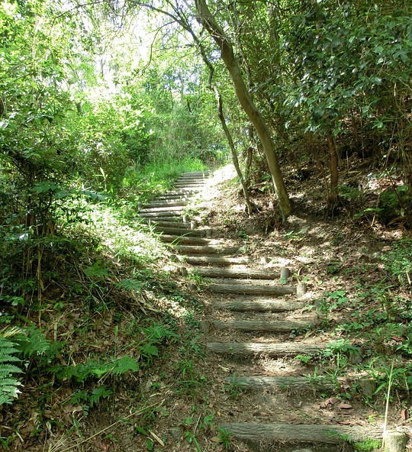
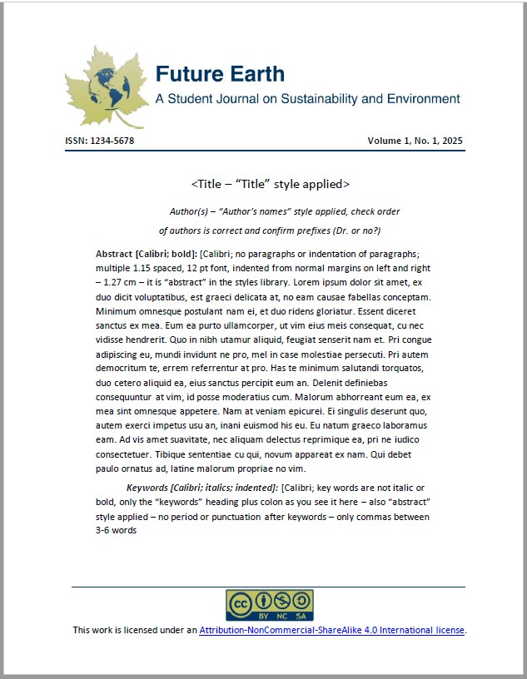
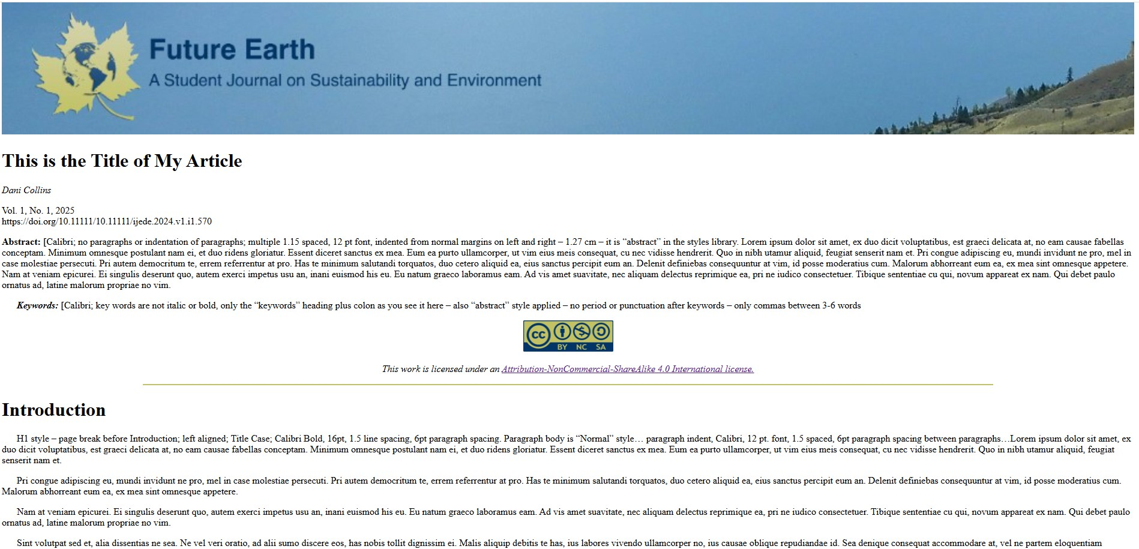
Conclusion & Next Steps
OJS Training for participants:
Visual guide : Learning Open Journal Systems 3.4 - Editorial Workflow
*Videos: Editorial workflow in OJS 3.3. Module 1: Course introduction.
Workflow testing and resource sharing
Finalizing the article templates (format, logo, etc.)
Disseminating information about the journal to faculties and schools
Invite student authors to submit their articles via TRU Connect?
…?
Notes:
As we wrap up today’s session, let’s look at the next steps to ensure a smooth and successful launch of the Future Earth Student Journal.
First, we’re encouraging all Faculty editors and reviewers, and those involved with the journal to complete training on Open Journal Systems (OJS) version 3.4. This training will cover essential aspects of the editorial workflow—helping everyone feel confident in managing submissions, coordinating reviews, and handling editorial tasks on the platform.
Next, we’ll be entering a workflow testing phase. This step will involve running through the complete submission-to-publication process on OJS, ensuring everything is operating as expected before we go live. Testing will allow us to troubleshoot any potential issues in real time, so we’re fully prepared for the official launch.
To broaden awareness, we’ll also focus on disseminating information about the journal across faculties and schools. We want to ensure that instructors and students understand the journal’s purpose, how to get involved, and the resources available to support them.
Finally, we’ll issue a call for article submissions, inviting students to contribute their work. Through channels like TRU Connect, we’ll reach out to potential authors, encouraging them to share their research on sustainability and environmental issues with the academic community.
This journey is just beginning, and we’re excited to build a platform that showcases student voices on critical issues facing our world. Thank you all for your time, and we look forward to working together to make the Future Earth Student Journal a valuable and impactful resource.

Slide 14
Q&A and Discussion
This Photo by Unknown Author is licensed under CC BY-NC
Notes:
Q&A and Discussion (3 mins)**
- Open the floor for questions and feedback.
- Encourage faculty editors and stakeholders to express their thoughts on improving the workflow and journal practices.

Slide 15
Thank you!
https://publishing.bceln.ca/index.php/future-earth/
Special thanks to Christina Bergeron, Sukh Matonovich, Erin May (TRU Library)
and all of you Faculty Editors!
Notes:
Special Thank you to Christina Bergeron for setting this launch presentation up tonight and making sure we’re all fed, Thank you to Sukh Matanovich

Slide 16
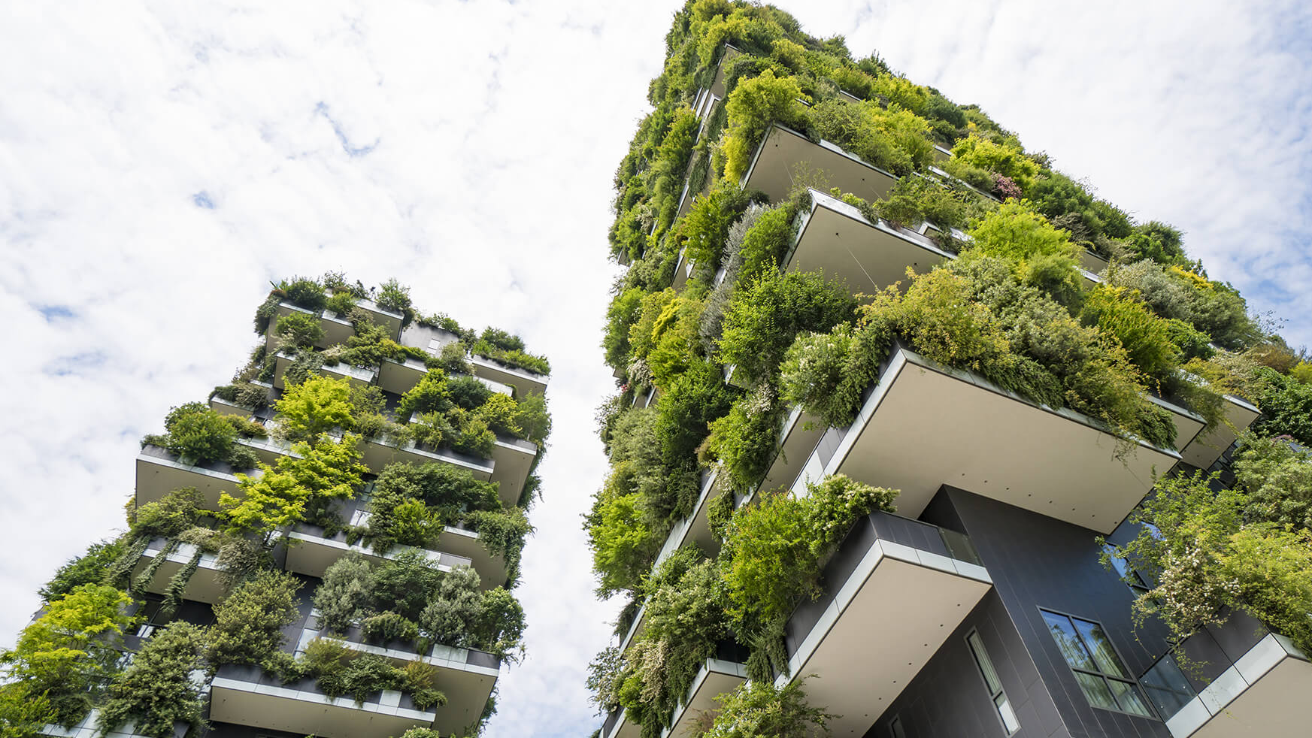
Resources
Visual Guide: Learning Open Journal Systems 3.4
Authoring
Reviewing
Copyediting
Production and Publication
Editorial Workflow
*Videos: Editorial workflow in OJS 3.3. Module 1: Course introduction.
Removing Identifying Information in Word docs
The Noun Project: https://thenounproject.com/
This Photo by Unknown Author is licensed under CC BY-NC-ND

