Slide 1

TRU Open Press
Inaugural Advisory Board Meeting
8 october 2024, 1 pm – 2 pm

Slide 2
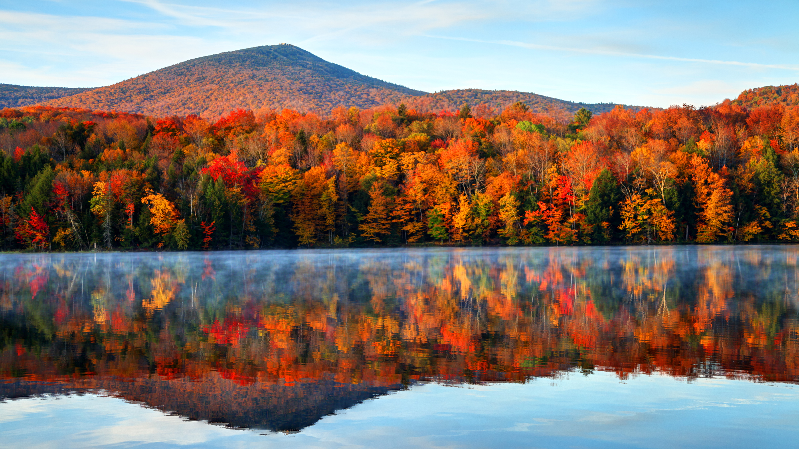
The team at the TRU Open Press is grateful to be visitors on Tk’emlups te Secwepemc territory within the unceded traditional lands of Secwepemcúl’ecw (Secwepemc Nation), where knowledge sharing has taken place since time immemorial.
Photo of the sky in Knutsford by James Wheeler, via Unsplash.

Slide 3
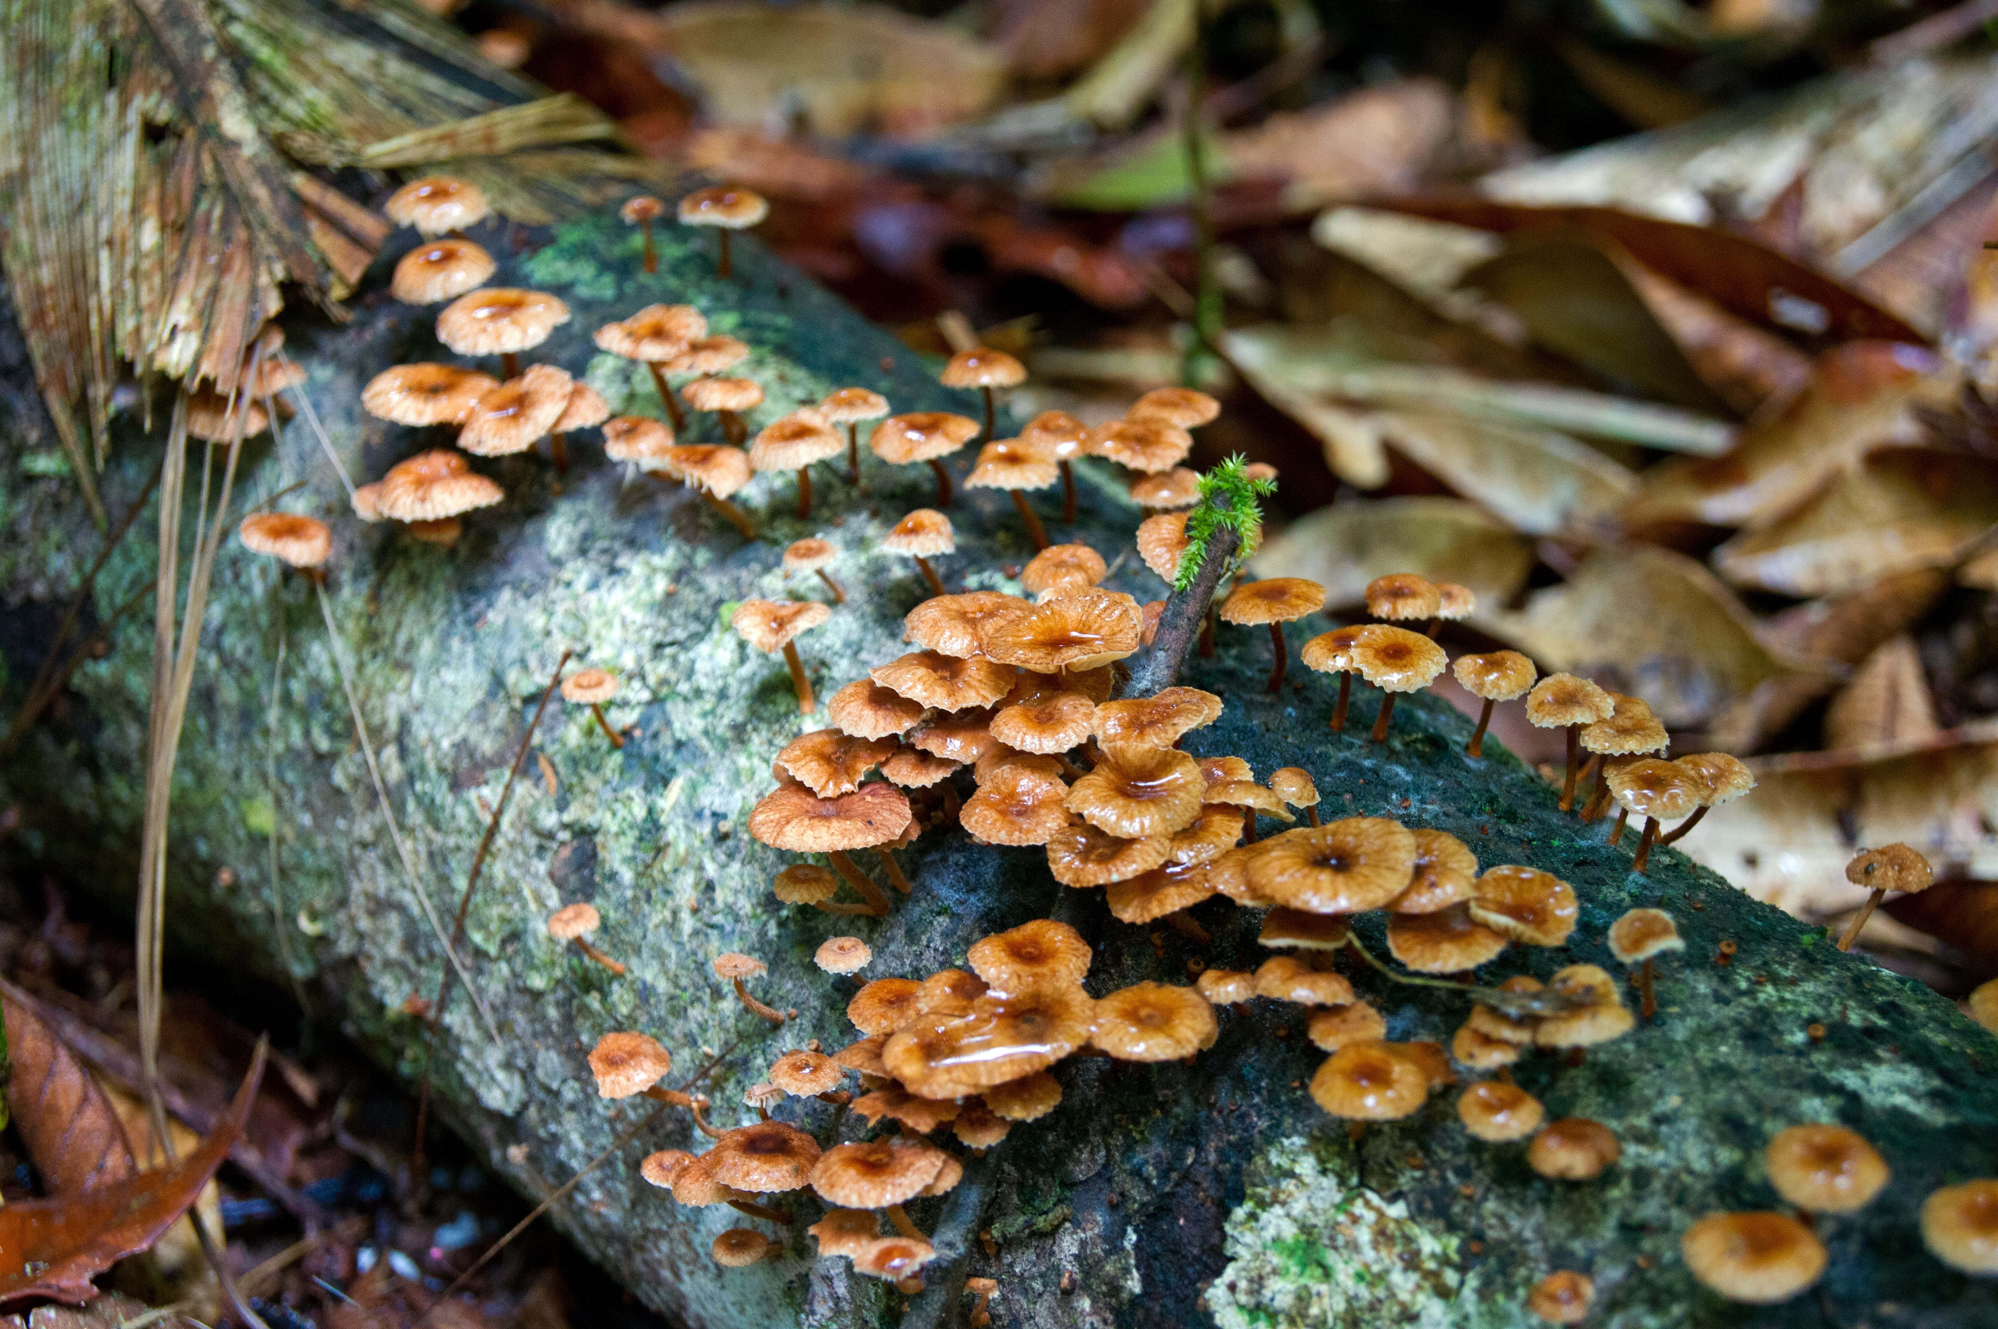
Welcome and Introductions
Marie and Brian to briefly introduce themselves as co-chairs.
Brian is interim co-chair while Brenna is away.
Board members invited to introduce themselves to the group.
Student representatives on the Board for 2024-2025 – Welcome back Bensley and Greg! ☺

Slide 4
Approval of the Agenda
(Circulated by Email)
May 27 meeting minutes approval
Publishing Manager’s project report
Strategic goals for the year
Open discussion and questions
Next Steps and Closing Remarks.
OP Project Adjudication and Selection Subcommittee

Slide 5

TRU Open Press Vision
The Open Press combines TRU’s celebrated open platforms and expertise in learning design and resource development to offer all-inclusive support for the development of open educational resources, scholarship, and pedagogy projects.
Our goal is to solidify the existing infrastructure to prepare for TRU’s transition to a research-first university and to support the existing community ethos of teaching and learning in the open.

Slide 6
Who We Are
Marie Bartlett & Brenna Clarke Gray
(away)
co-founders and project leads
Dani Collins:
publications manager
Jessica Obando Almache:
production specialist
Kaitlyn Meyers:
copy editor
Aiko Uehara:
co-op student
Riley Philips:
co-op student
Suleiman Jibril-Ahmed (“Jibril”):
co-op student

Slide 7
Year Two: We’re focused on completing and promoting previous projects, starting newly approved projects, and supporting other open and ISP initiatives.
Publishing Manager Dani Collins will speak to some of the projects undertaken and completed with Year One funds (2023-2024).
Year Two (2024-2025): our adjudicated project model has begun
Additional projects and initiatives supported by Open Press

Slide 8

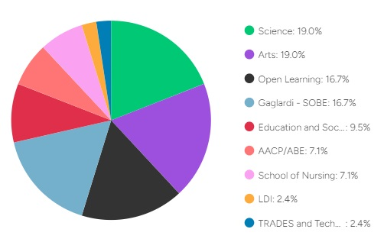
2023-2024 Projects
24 projects completed
Plumbing Apprenticeship Level 2 to be done January 2025 – Level 1 to begin development in March 2025
7 projects carried forward ; 2 in content development, one needs copyediting; most waiting for impact interview/ story
“not started” projects – many supported by LT&I group instead (e.g., public art project (Exner)

Slide 9
2024-2025 Projects
OER for Use in the Education and Skills Training (ESTR) Program – refresh for existing OER and new resource website
Chemistry Laboratory Safety and Techniques - videos and website
PASS Chem to Pressbooks Version 2.0 – new solutions to be added to existing website
Organic Chemistry Digital Learning Resources – lightboard videos and website
Co-design of an innovative genomic nursing educational hub – Linkage 2.0 website – videos and H5P
Indigenous Medicines of the Cayoose Creek Band in Sekw’el’was – OER textbook
Graphic summary “cheat” sheets to accompany each Chapter in “Open Genetics” – to be added to OER textbook
Tourism, Hospitality, and Services Marketing – OER textbook and website
Open Education Practices: Case Studies in Ethical Leadership – OER Pressbooks and website
Algebra Essentials: Tools for Success in Precalculus and Beyond – lightboard videos
10/16 projects approved
1 new project proposal post-September to be reviewed
All applicants provided feedback and asked to resubmit if they wished
Project Selection Subcommittee to comment

Slide 10
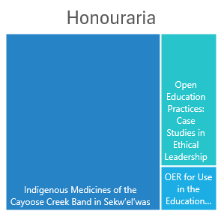
2024-2025 Projects
Students
5/10 projects hiring students
  4 Research Assistant - rehires
  2 Research Assistants – new hires
  1 student service hires – to be PSA (one student from 2023-2024 project)
2 new co-op students on OP Team and 1 co-op student returning from previous term

Slide 11
Additional projects and initiatives supported by Open Press
PLAR OER
Knowledge Makers, Volume 9
Future Earth:
Honours College –
LibreText conversion to Pressbooks (CHEM 1500 and CHEM 1510/1520)
OL CHEM

Slide 12
The Purpose of the Advisory Board
To represent constituency groups important to the development of Press projects.
To advise Press leadership on academic standards, potential partnerships, financial sustainability, innovation, and inclusive practices.
To act as ambassadors for the TRU Open Press.
To select projects for development by the Press.

Slide 13
Project Selection (Adjudication)Subcommittee
This Subcommittee:
  Reviewed projects after intake (1 May) according to the Project Review Matrix.
  Decided by consensus which projects will be funded.
  Completed their work in time for funds to be disbursed by 1 September.
  Re-convene if funds allow for a second call mid-cycle.
The Subcommittee must consist of a five people, including one Chair and (at least) one student representative.
The Publications Manager will act as an advisor to the subcommittee.

Slide 14
Strategic Goals for the Year
2023-2024
Support the Press-related needs of the TRU Honours College and any other TRUScholars–funded projects.
Maximize the disbursement of funds to open projects across the campus community, with attention to diversity of projects and number of areas of campus touched.
Maximize the student opportunities funded by the Press.
Work towards sustainable funding for the Press.

Slide 15
Strategic Goals for the Year
2024-2025
Support the Press-related needs of the TRU Honours College and any other TRUScholars–funded projects.
Continued promotion of projects and OER
Continue to maximize student opportunities funded by the Press.
Work towards sustainable funding for the Press.

Slide 16
Question to the Board
How can we promote open education resource development, scholarly research publishing, and open pedagogy? [last question]
What strategies can we implement to ensure the sustainability and long-term impact of our Open Press projects, while fostering broader engagement from faculty and students?

Slide 17

Open Discussion

Slide 18
Closing Remarks
Next meeting to be held in April, date TBA:
  Please mark your calendars for our next meeting, and feel free to reach out if you have any additional thoughts or questions in the meantime.
  Publications Manager will report out on the Fall/ Winter work of the Press.
Gratitude from Marie & Brian for the contributions of everyone here today.

